Slide 1
What’s Next After Hands-On Training?
Consider USCC Certification:
Continue Learning through
Compost University™
Utilize the USCC Career Center

Slide 2
What’s Next After Hands-On Training?
Consider USCC Certification:
CCOM™ - Certified Compost Operations Manager™ - If you work AT a facility
CCP™ - Certified Composting Professional™ - If you work WITH composting facilities
Continue Learning through Compost University™
Learn Here. Grow Here. THRIVE Here.™
160+ courses from beginner to advanced
14 topic areas including composting technologies, diversion and science
Earn Continuing Education Credits
Utilize the USCC Career Center
Featuring jobs, career advice and resume building exclusive to the compost industry.

Slide 3
WHY GET YOUR USCC CERTIFICATION?
CCOM™ - Certified Compost Operations Manager™
CCP™ - Certified Composting Professional™
“I pursued the CCOM through the USCC to test the knowledge that I have gained about the industry and managing all aspects of a composting operation. I also pursued this to gain the credentials required in the NC Compost rules.”
- Tim Gainor, Operations Supervisor for the City of Raleigh, NC Yard Waste Center
“I was motivated to pursue the Certified Compost Professional program offered by the USCC as a way to demonstrate to processors out in the field that I am competent and will be a positive working partner with them. It was exciting to be able to apply the five years of commercial composting experience I gained towards a certificate program. The certification program seemed like a logical next step in my professional path.”
- Elly Ventura, Product & Zero Waste Specialist., Vegware US

Slide 4
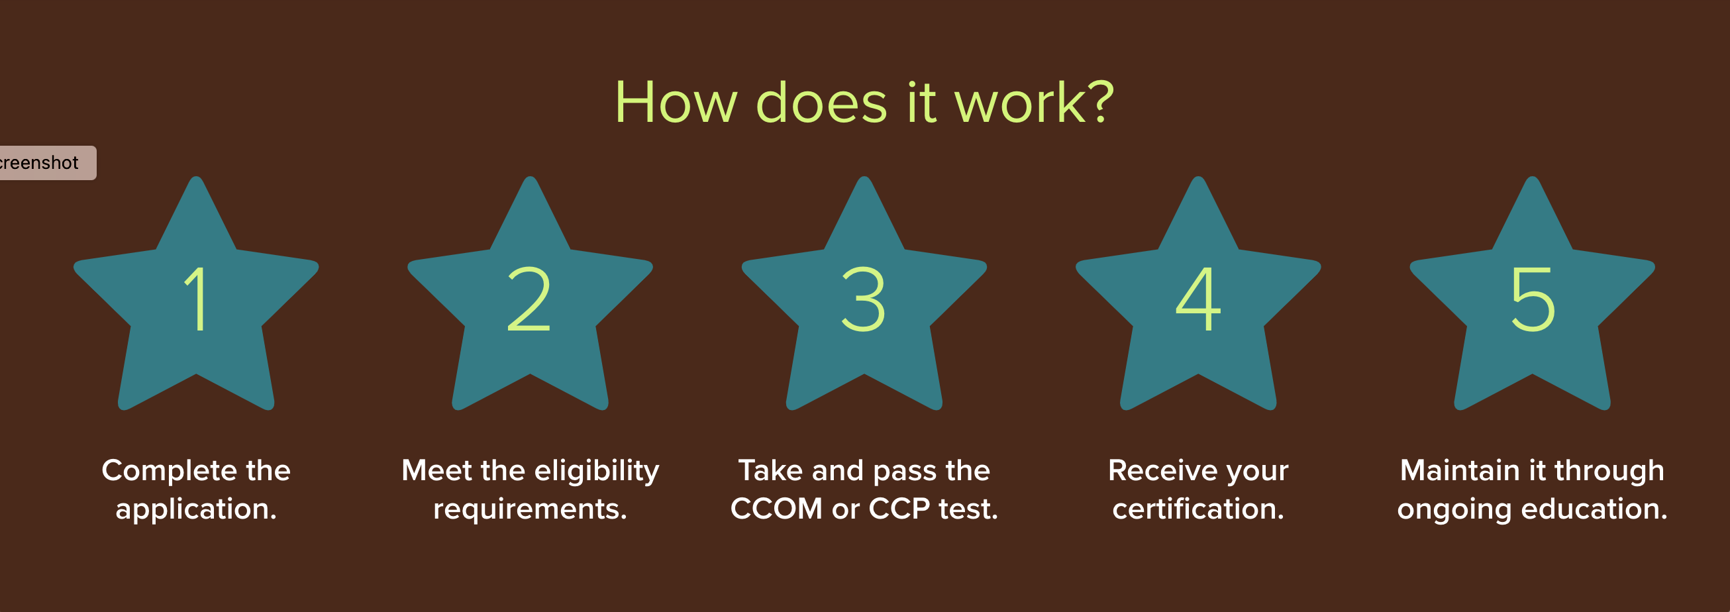
21 or older
High school graduate or GED, or equivalent
Training (3-day course or more, must include hand’s on)
CCOM CCP
2 years Exp, one at Compost site -4 years related, relevant experience

Slide 5
Are You Ready?
Learn More Here ….
www.certificationsuscc.org
www.compostu.net
www.compostjobs.com
Contact: Teri Sorg-McManamon, Director of Professional Development
610-390-7930 • tsmcmanamon@compostingcouncil.org

