Slide 1
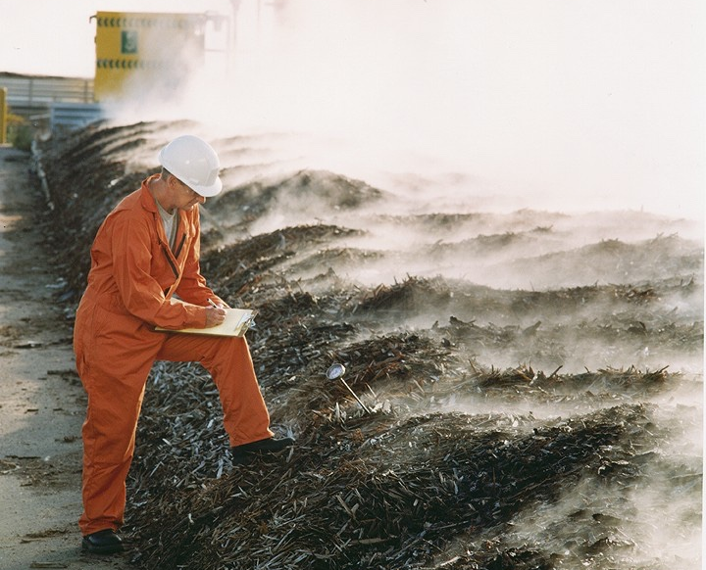
Data Collection/Process Monitoring
Notes:
Practice good process management

Slide 2
Recordkeeping
Good recordkeeping is essential
Records allow site managers to measure performance against goals, comply with rules, make better compost, and plan.
“Operating Record” refers to all the data that provides details and documentation of the facility’s status and operating history.

Slide 3
Common Records
Production
Tons in/tons out
In-process
Process
Temperature
Turns
Moisture
Regulatory
Pathogen Reduction
Heavy Metals
Inerts
Finished Product
Micronutrients
Stability/maturity
pH
Electrical conductivity
Organic matter

Slide 4
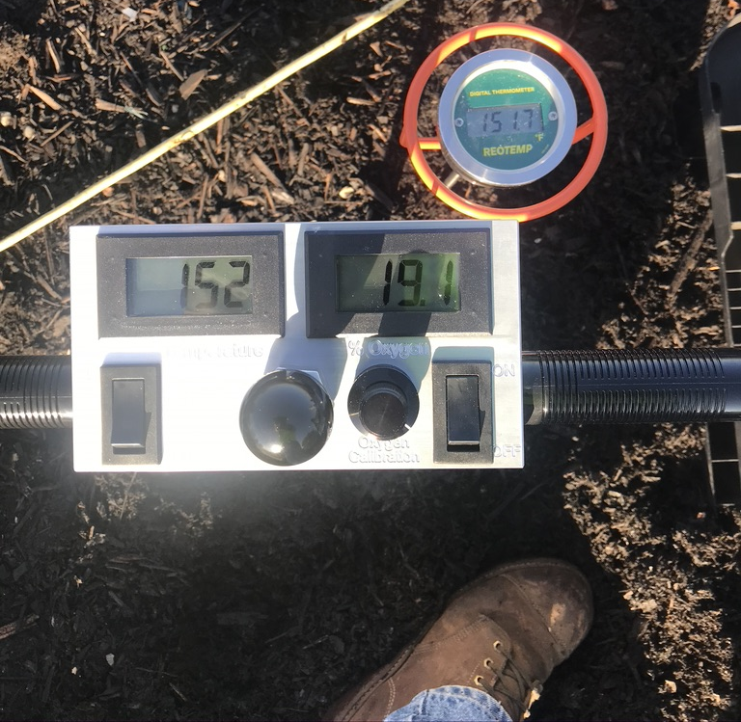
Temperature
Notes:
The single most useful measurement that things are working.

Slide 5
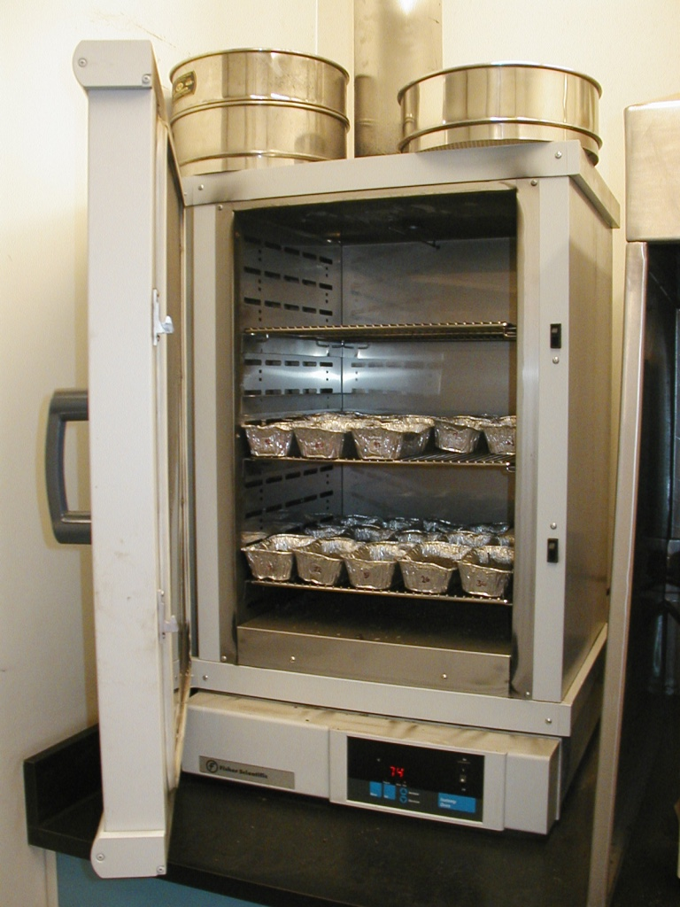
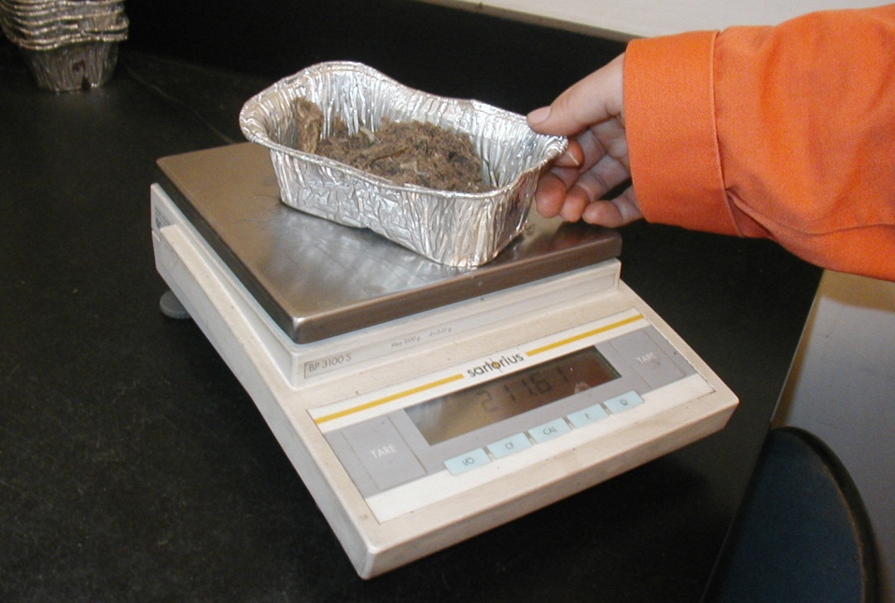
Testing for Moisture
Weighing the dried sample
Drying oven
Wet Weight - Dry Weight / Wet Weight x 100 = Moisture percentage

Slide 6
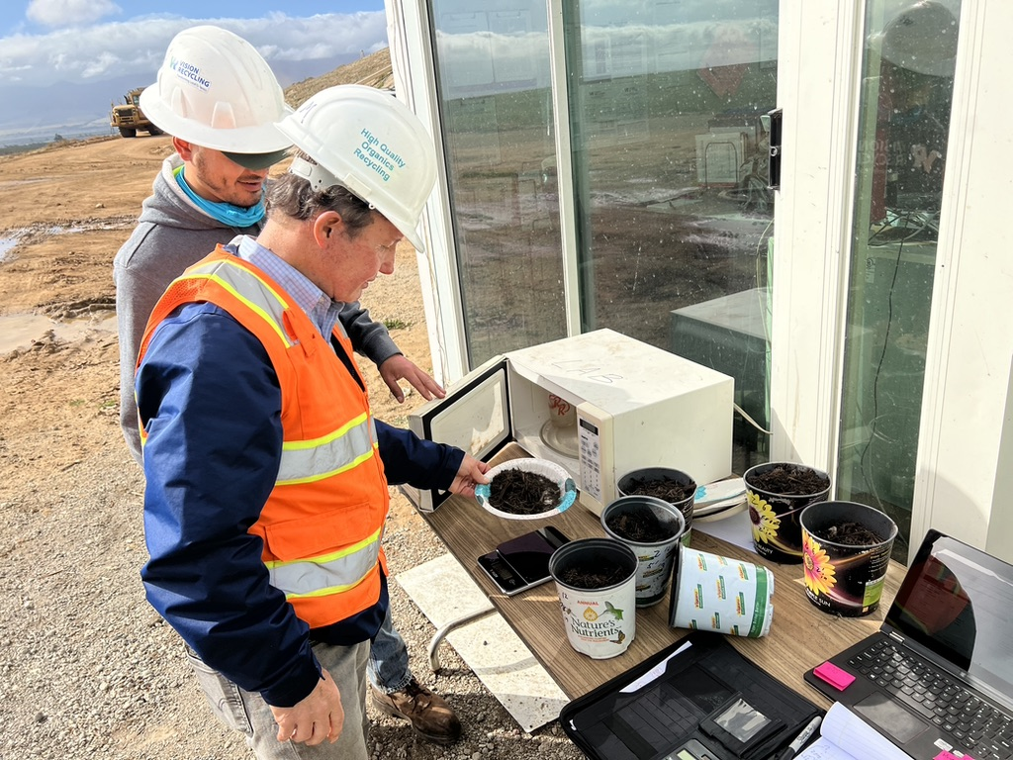
Quick Test for Moisture
Notice the operators are outside
Microwave oven
Digital scale
Wet Weight - Dry Weight / Wet Weight x 100 = Moisture percentage
Notes:
Example: Wet Weight = 100 grams
Dry Weight = 60 grams
100 grams – 60 grams/ 100 grams x 100 = 40%
- The units don’t matter, as long as they are consistent
- Use 100 (units) or 10 (units) to keep the math easy
- Don’t forget to subtract the weight of the container (Tare)

Slide 7
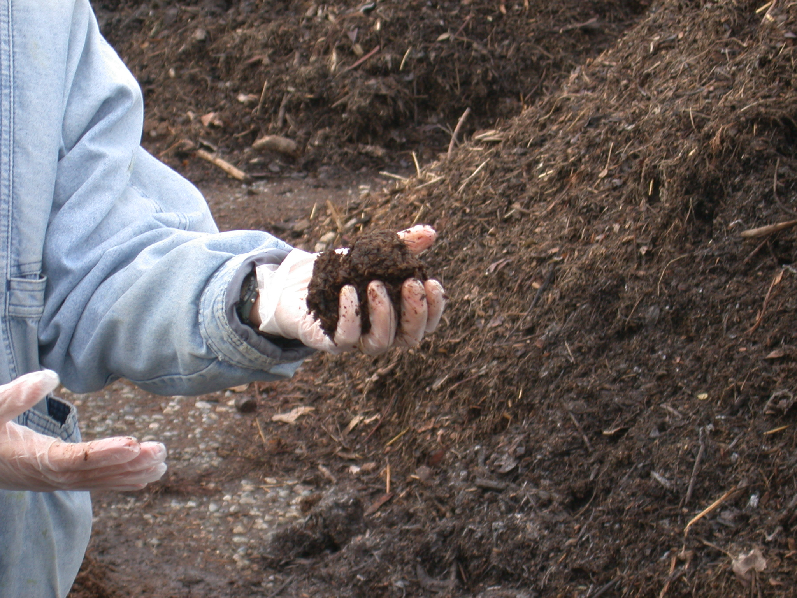
Moisture – Squeeze Test
Just right!
(50 to 60% water by weight)
Notes:
Some feedstocks (especially manures) can hold even more moisture.

Slide 8
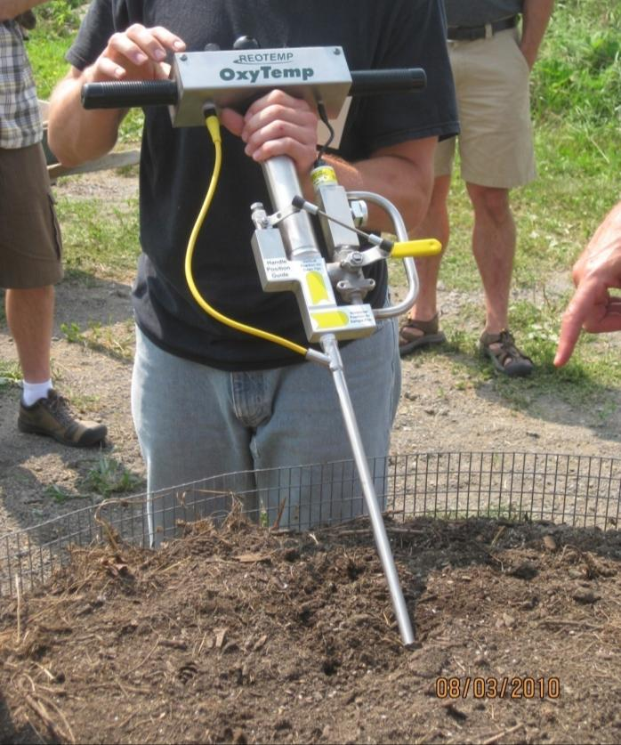
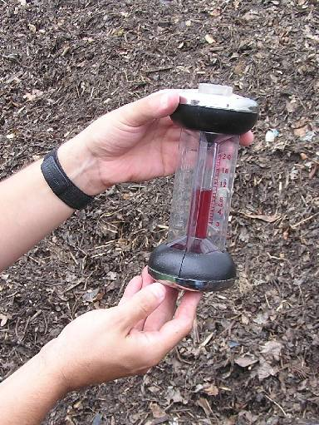
O₂/CO₂ Monitoring

Slide 9
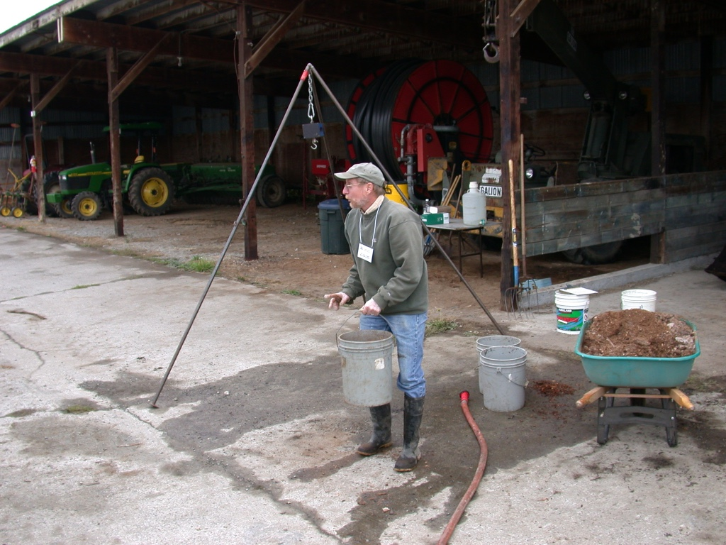
Measuring Bulk Density

Slide 10
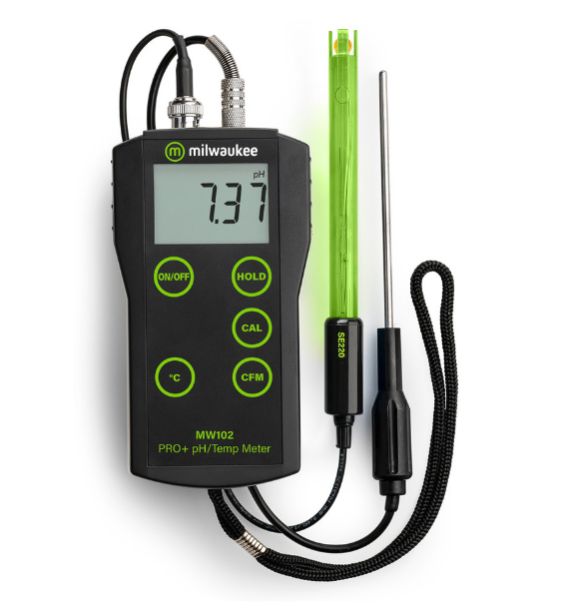
pH?
Affordable hand-held meters available
More commonly done by a lab.
TMECC Methods exist

Slide 11
Questions?

Slide 12
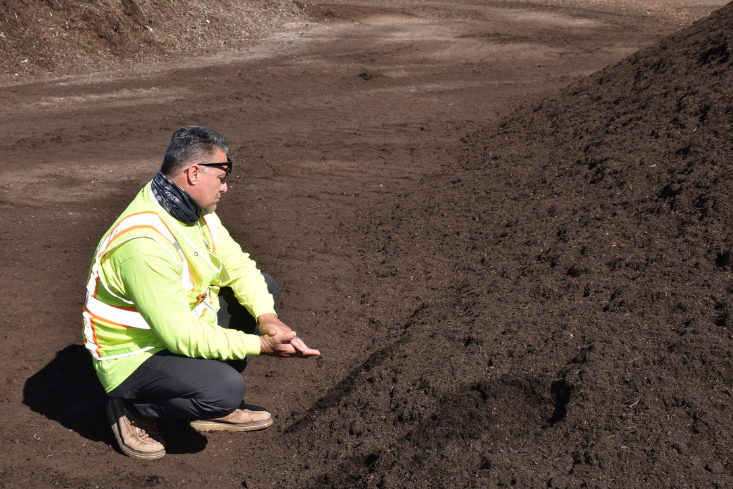
An Introduction to Lab Testing
Notes:
Because you can’t tell that much from looking at it!

Slide 13
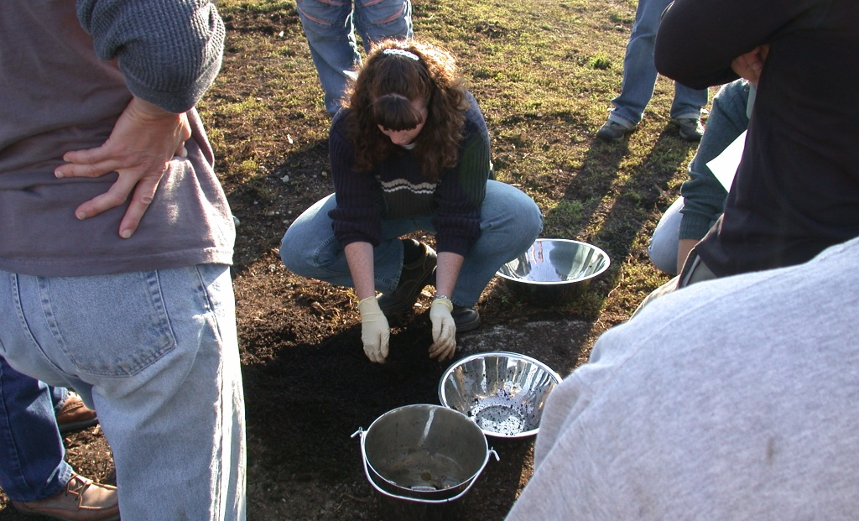
First, Take a good sample

Slide 14
No, Really, you Need to Take a Good Sample
https://www.compostfoundation.org/Sampling-Video
Notes:
Random & Representative
Take a good sample, handle and store it pr
Get it to the lab expeditiouslyoperly

Slide 15
Laboratory Testing
You need a relationship with a lab.
Regular testing is critical
Use compost (not soil or water) methods
TMECC
May be required for regulatory compliance
May be required for sales & marketing

Slide 16
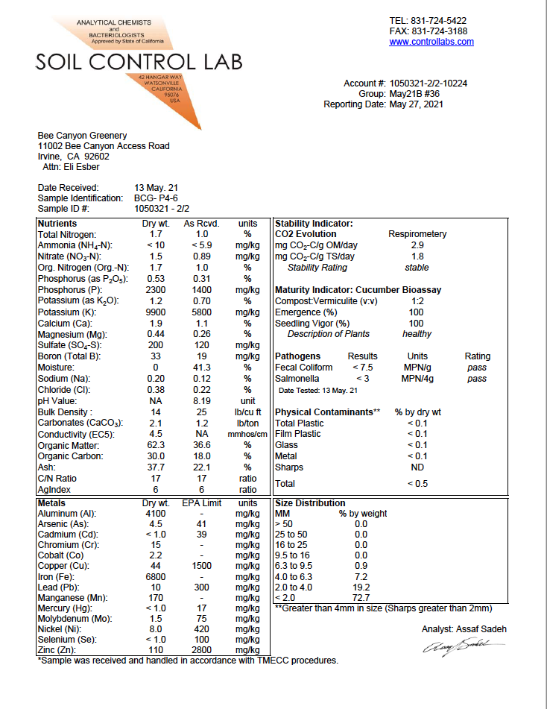
Compliance First:
Metals
Pathogens
Physical
Contaminants
R
R
R

Slide 17
Stability: Degree of Completion
Maturity: Plant Beneficial

Slide 18
Physical and Chemical
Characteristics

Slide 19
Physical and Chemical
Characteristics
Organics Matter/Ash
C:N Ratio
Moisture
Conductivity/eC5

Slide 20
Physical and Chemical
Characteristics
Nutrients, etc.

Slide 21
Lab Testing Wisdom
Understand when the lab needs the sample and what volumes and sample times are (send on a Tuesday, not a Friday).
Make sure you are using a compost lab (not a water or soil lab) or at least compost methods (TMECC).
If you fail a regulatory test. Do not panic. Re-examine your sampling and handling procedures and re-send a new sample.
Do additional tests based on what customers want to see.
Don’t be afraid to ask the lab questions: great resource.

Slide 22
Questions?

