Slide 1

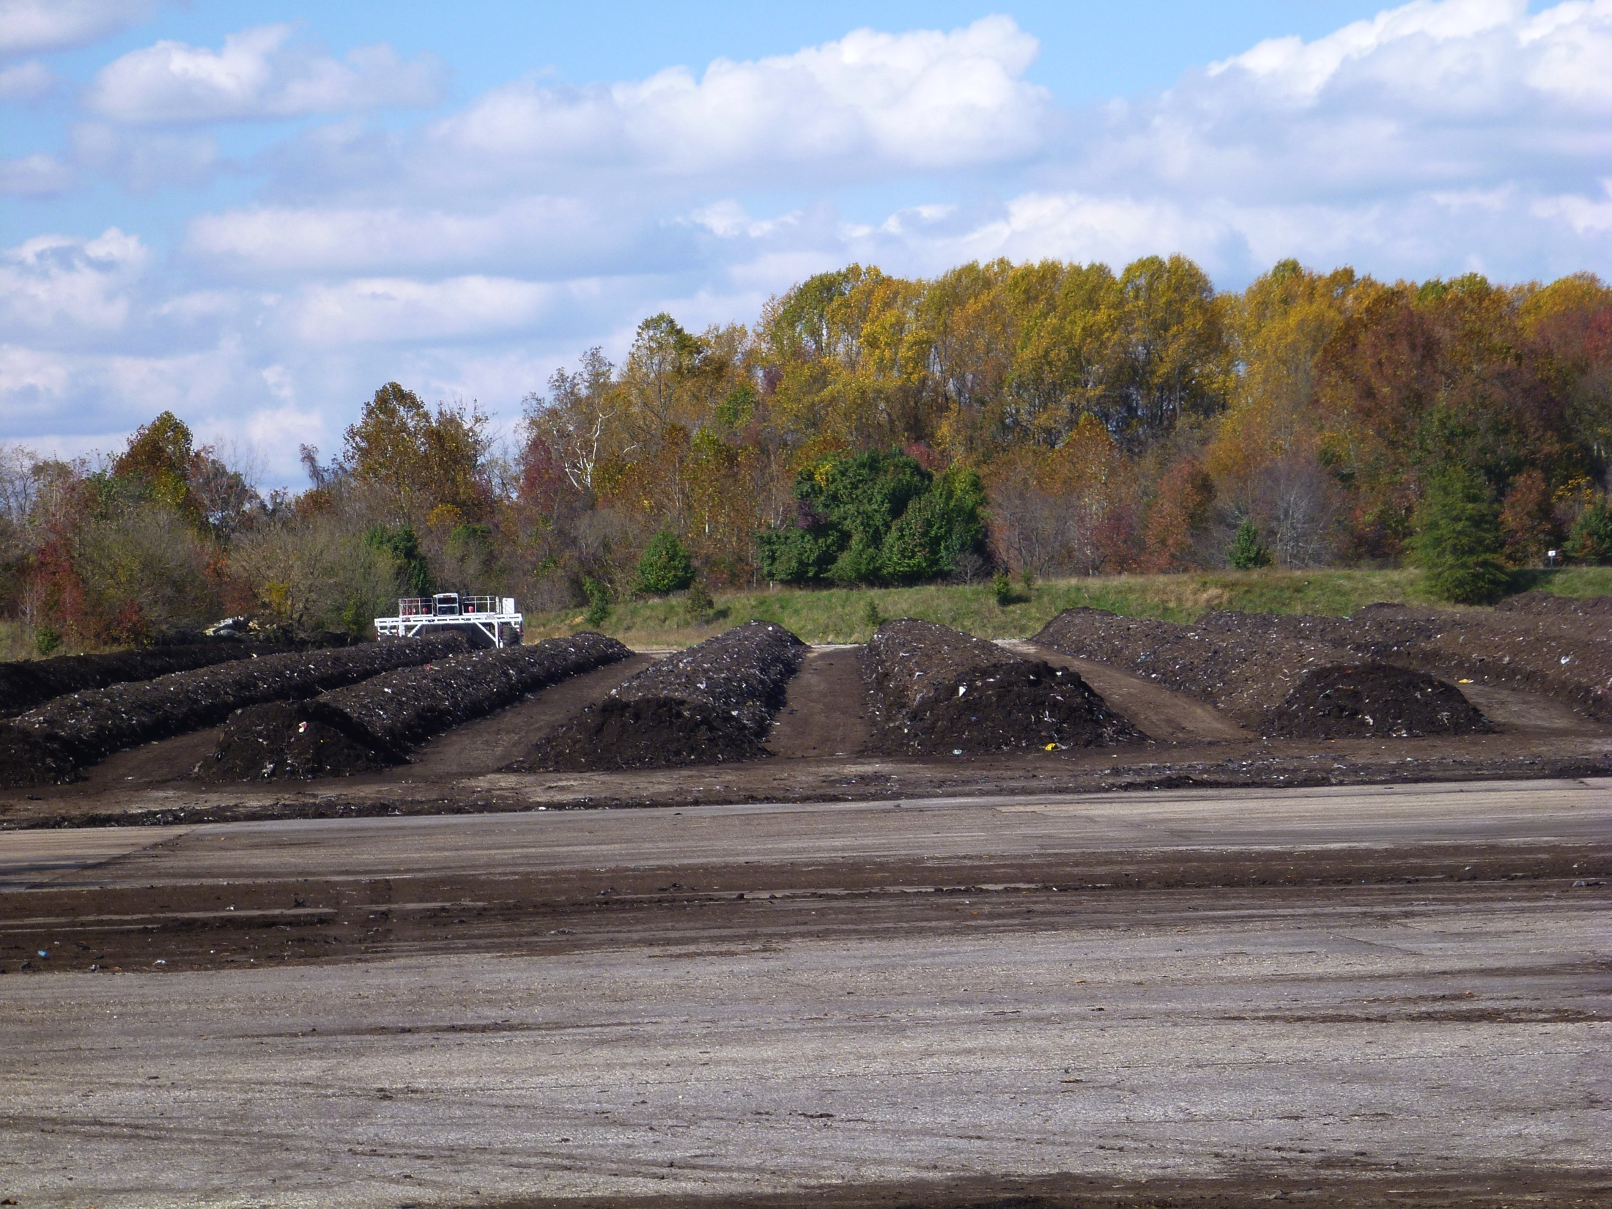
Lesson 4:
Basic Principles of Composting
Compost Basics
Feedstock Characteristics
and Recipe Development

Slide 2
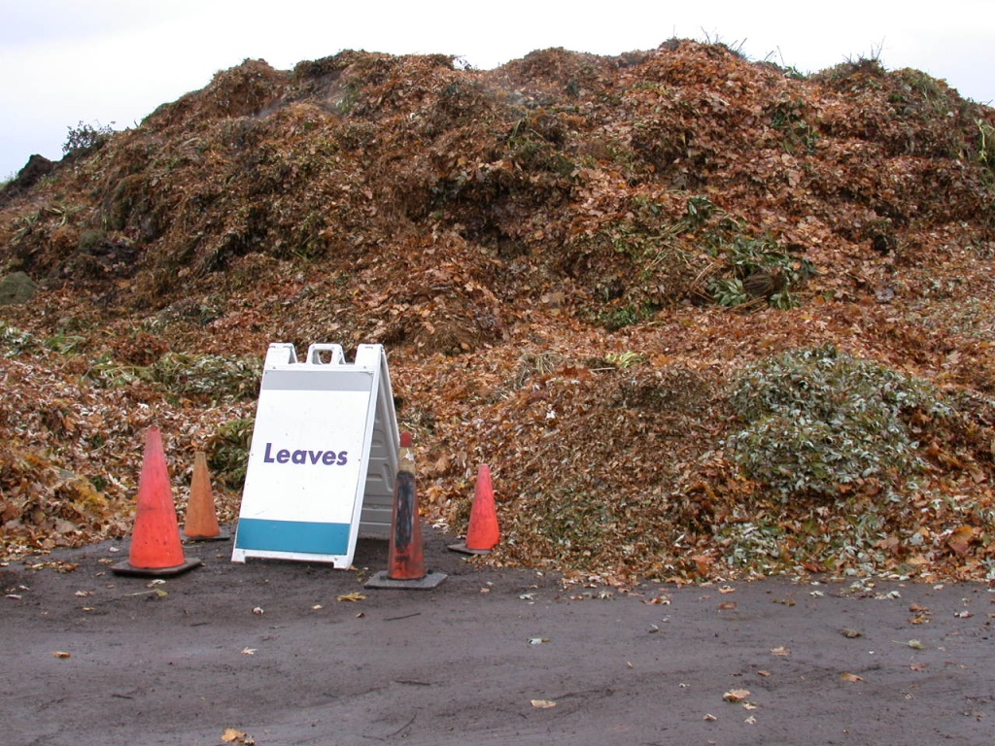
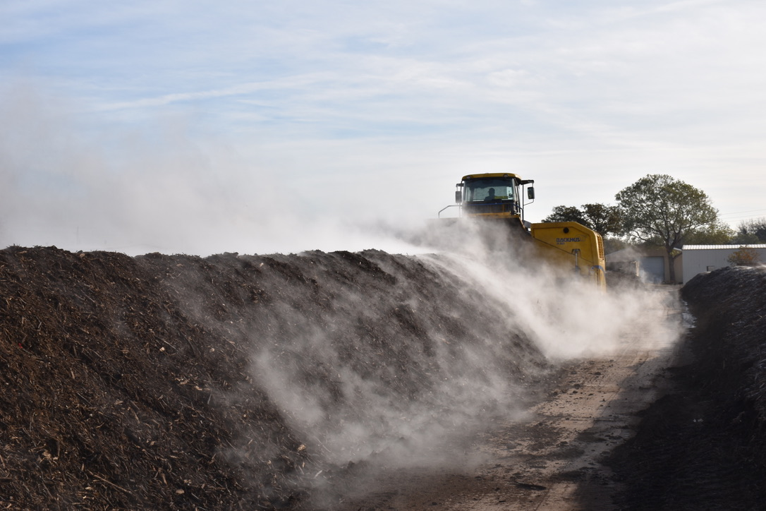
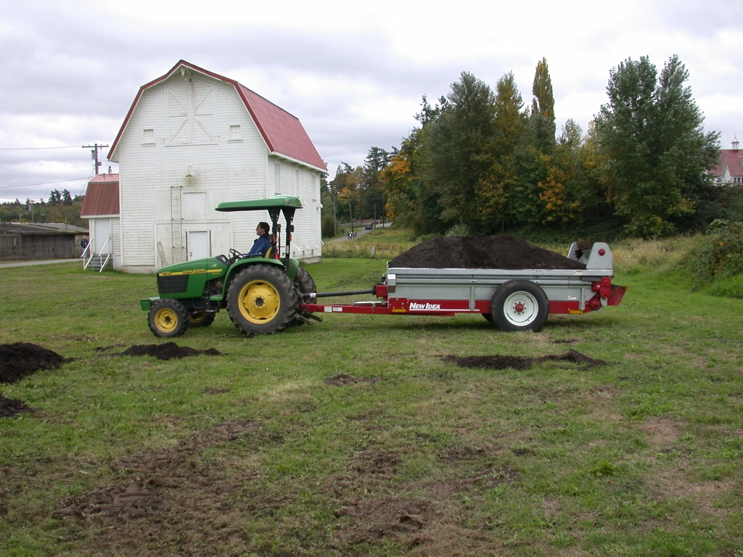
What Does
Composting Do?
Notes:
Transforms a difficult to handle material with limited uses into a stable, easily handled, easily stored material with a variety of uses.
Creates a product with value – compost.

Slide 3
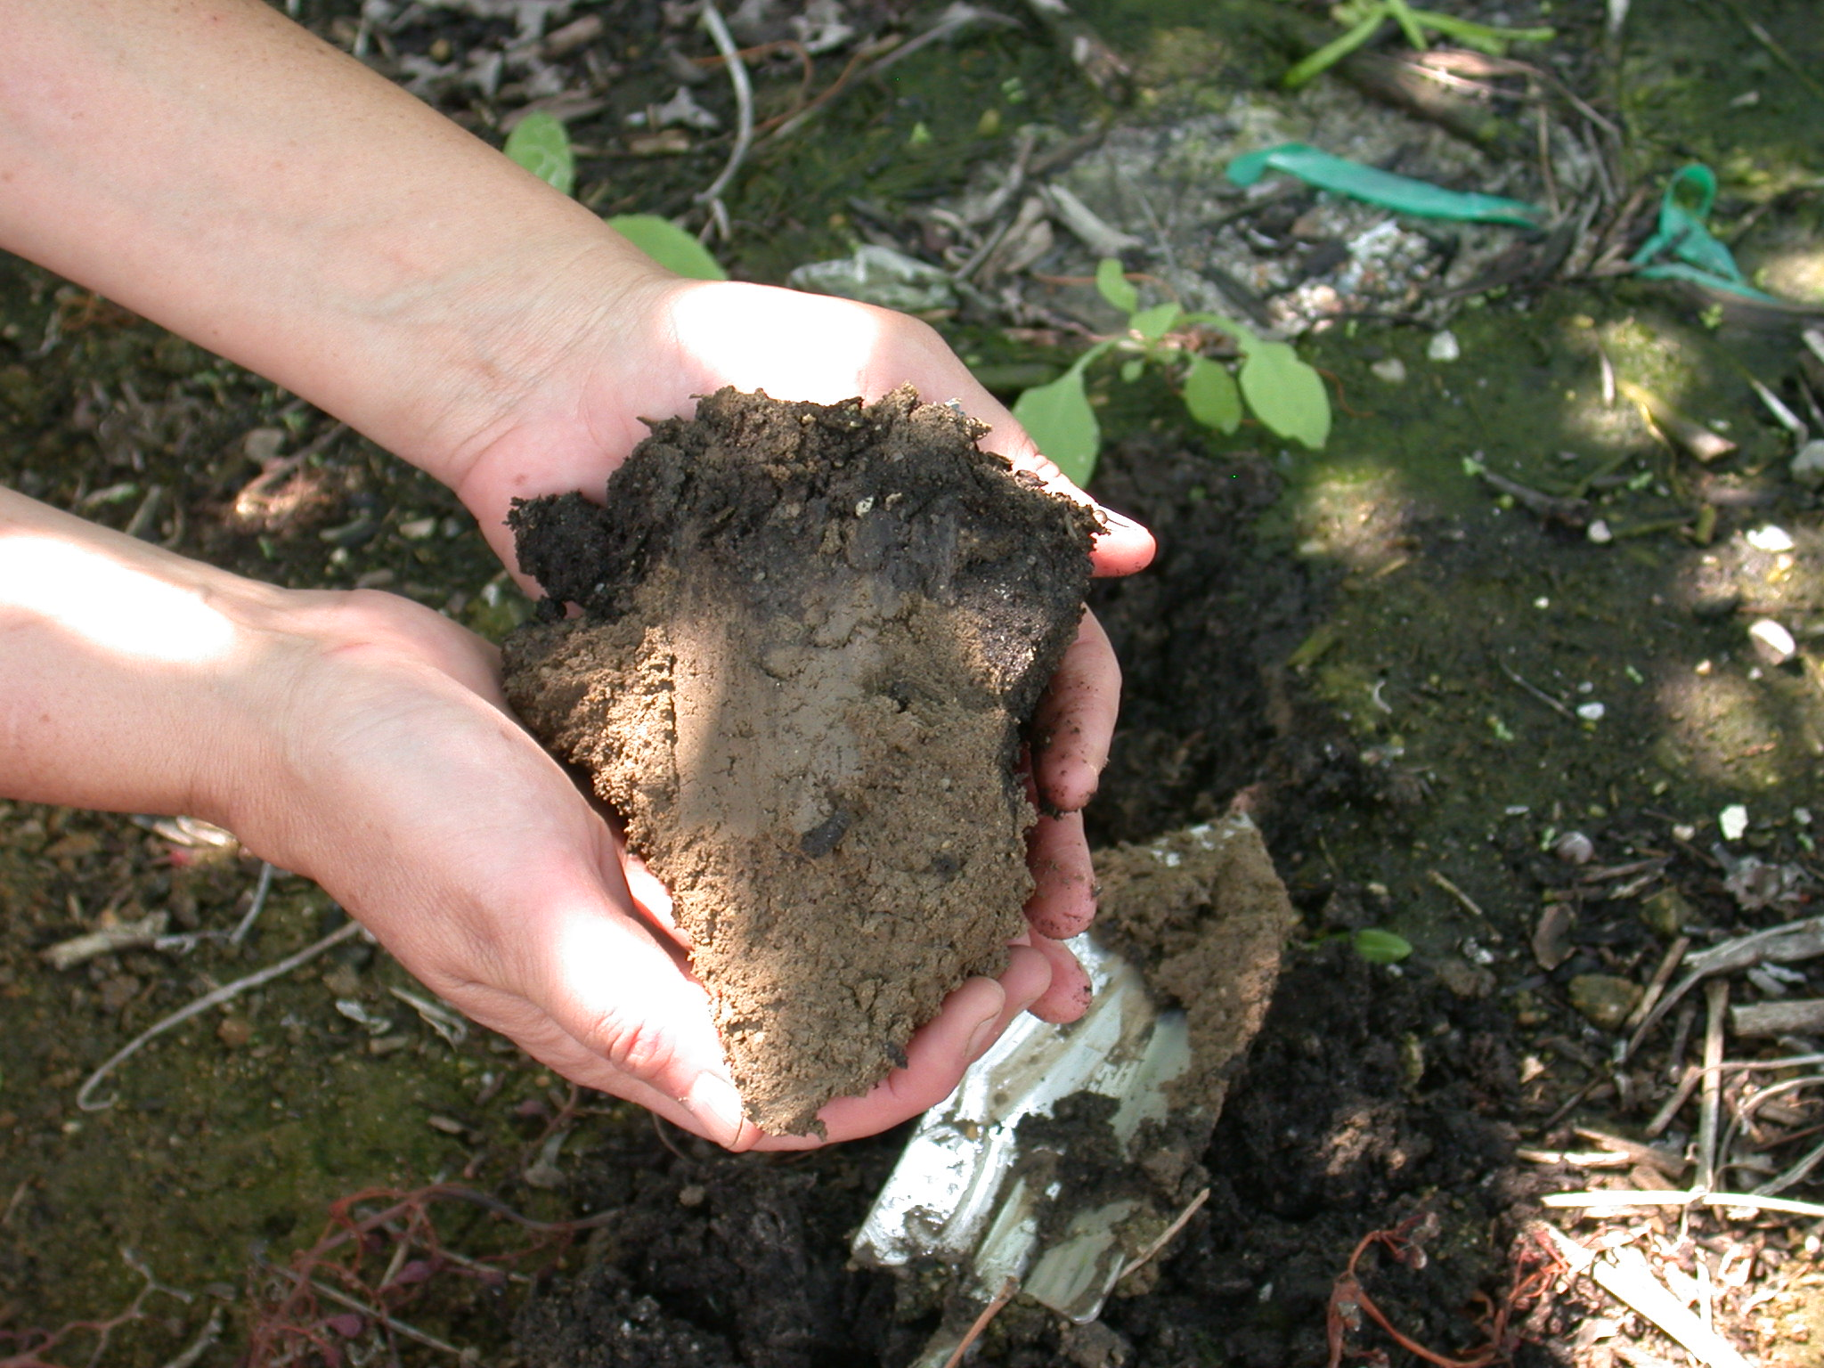
It’s all about the soil
Notes:
10 years of compost application to table grapes.

Slide 4
Benefits of Compost to Soil
Source: Brown, S. and Cotton, M. 2011. Changes in Soil Properties and
Carbon Content Following Compost Application: Results of On-farm Sampling.
Compost Sci. Util. 19:88-97

Slide 5

Why Compost?

Slide 6


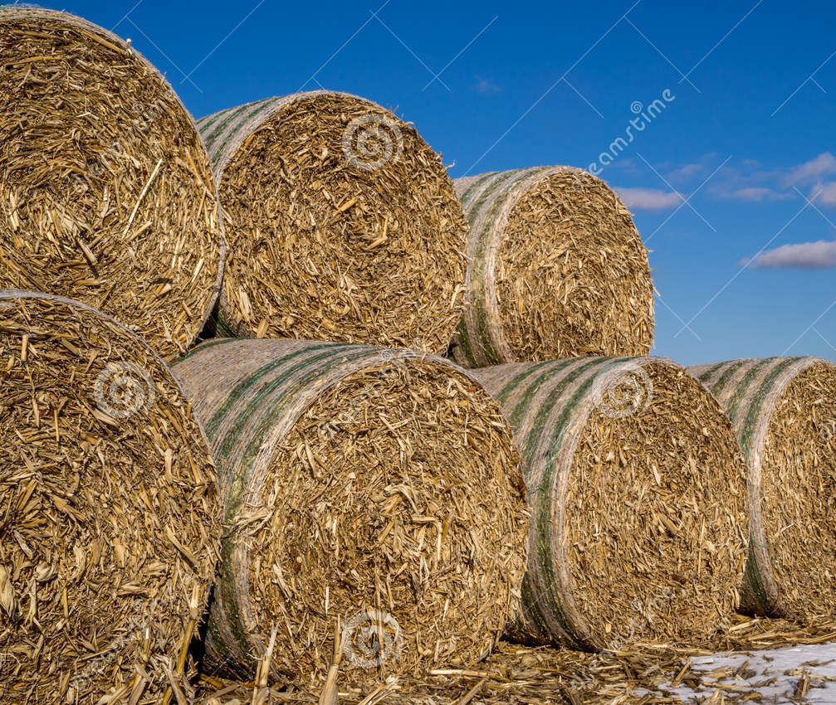
Replacing Organic Matter
Not much organic matter left

Slide 7
The Composting Process is:
Biological (run by microorganisms)
Works on organic feedstocks
Is an extension of natural decay
Controlled/managed, and accelerated
Aerobic, or predominantly so
Heat-generating and typically thermophilic (but not in all instances)
Produces compost

Slide 8
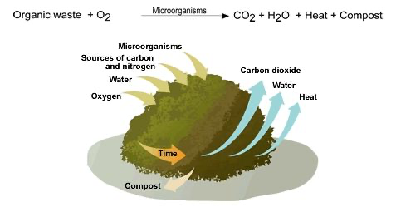
The Composting Process
Graphic Courtesy Waste Agency of Catalonia
https://residus.gencat.cat/es/ambits_dactuacio/valoritzacio_reciclatge/instal_lacions_de_gestio/tractament_biologic/el_compostatge/

Slide 9
What is Composting?
A natural, biological process.
A manufacturing process.
A tool to manage solid waste issues.
A way to reduce GHG.
Same process, used in many different contexts.

Slide 10
Microorganisms (“bugs”) do most of the work

Slide 11
Microorganisms eat
Organic Matter
Derive nutrients and energy from Organic Matter
Create compost, and become part of the compost
Note: they are eating on the surface

Slide 12
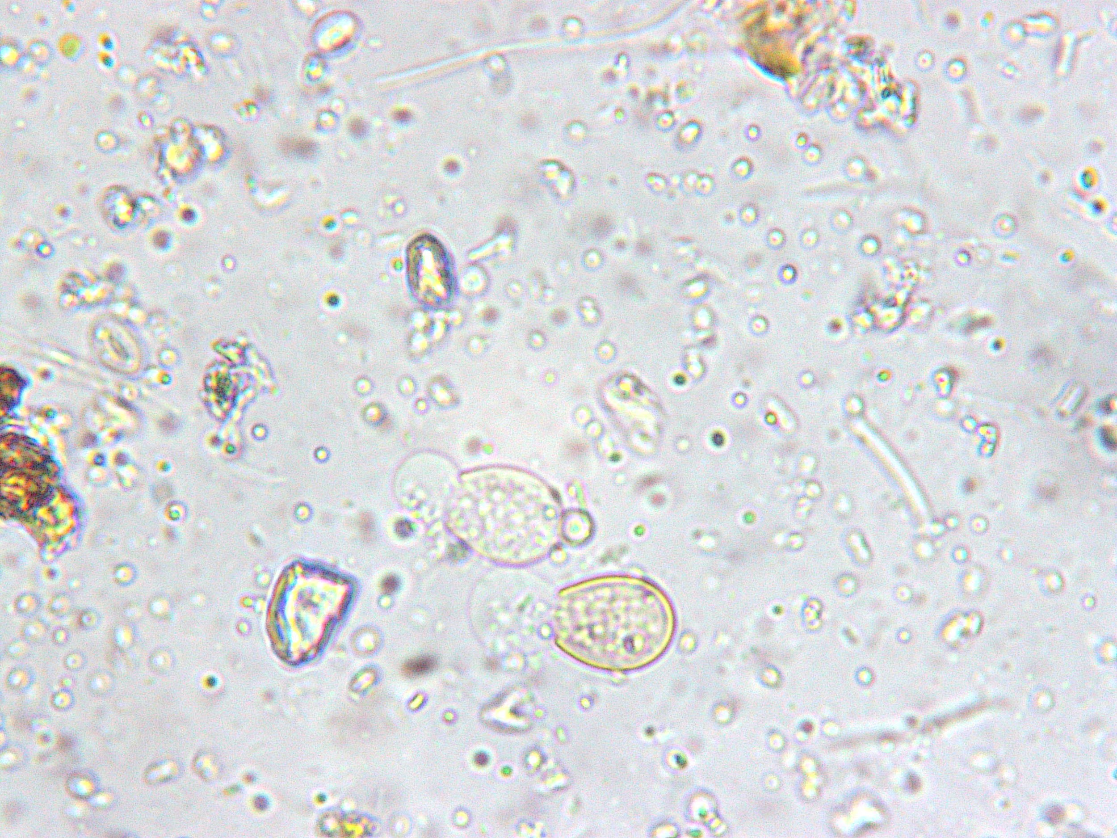
Photo Courtesy Lynn Fang, CalPoly Pomona.
Fresh, hot compost
Notes:
Bacteria, fungi,

Slide 13
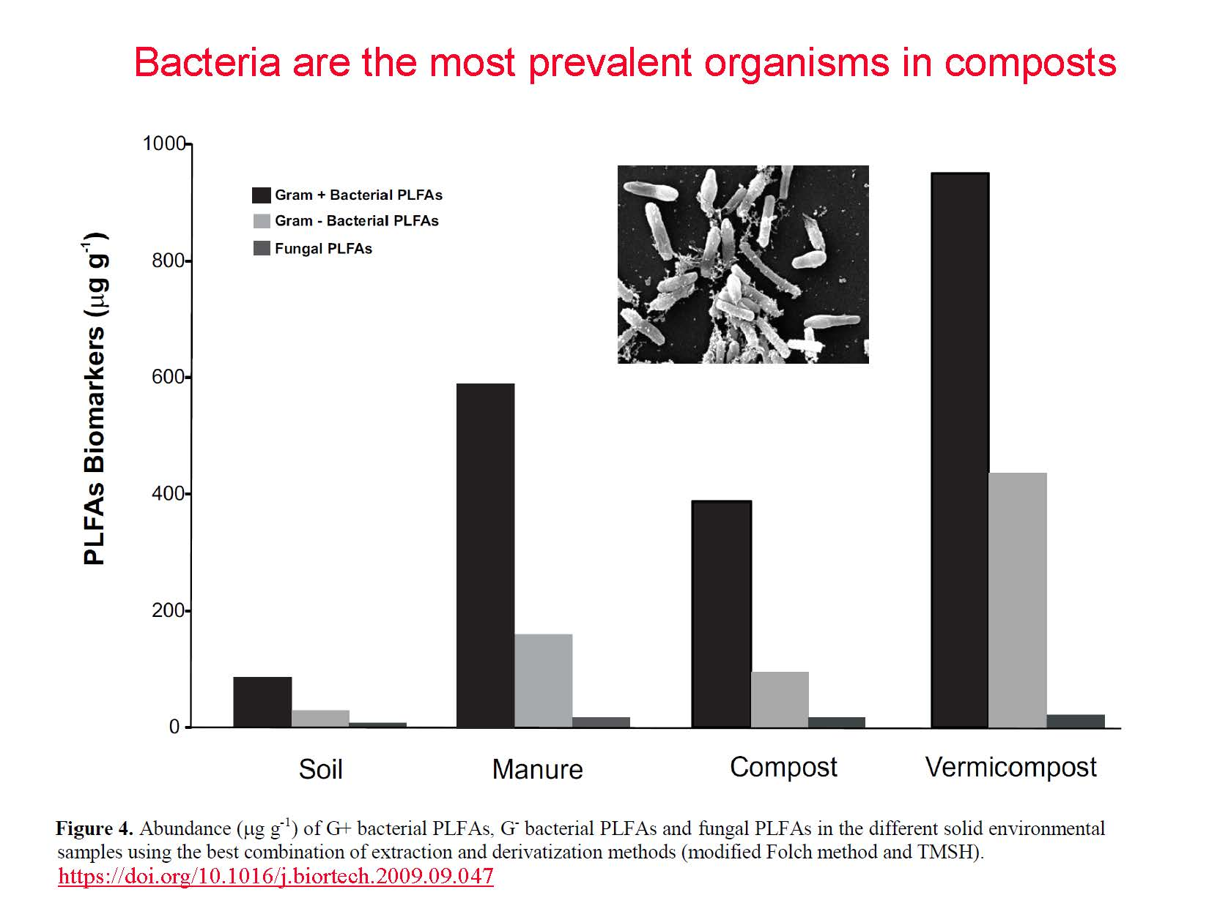
Slide courtesy of Fred Michel, OSU

Slide 14
The Key Factors
1. Moisture
2. Oxygen and aeration
3. Pile “mechanics” – density, porosity, particle size, structure, and shape
4. Feedstocks and their mix
5. Temperature
6. Composting time
14

Slide 15
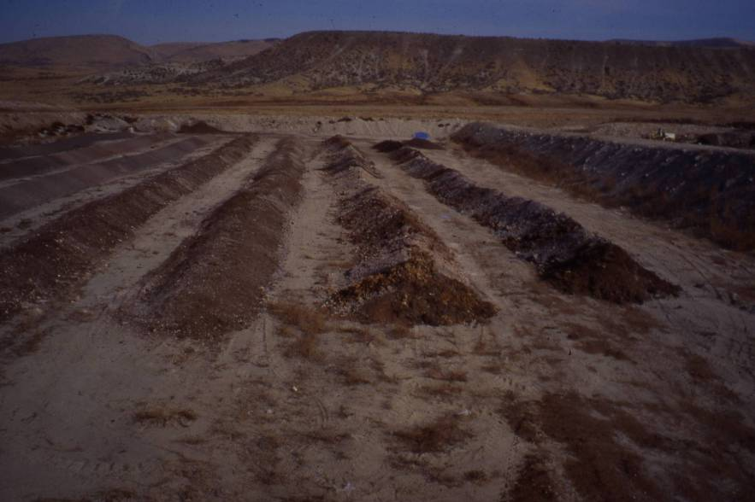
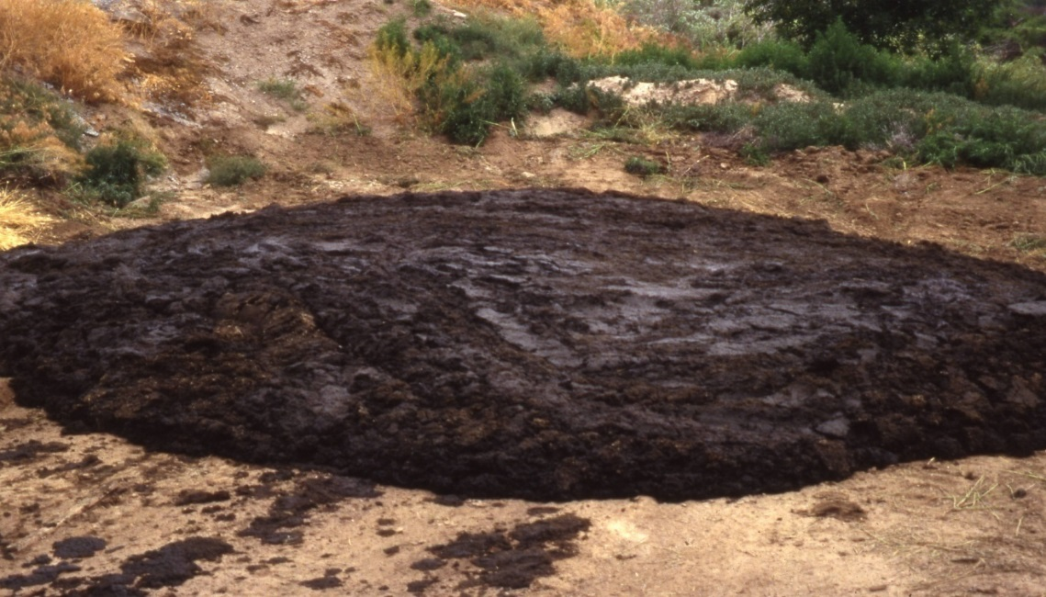
1. Moisture
Too dry!
Too wet!

Slide 16
Moisture Range
65%
Too wet
Wet, heavy, pores filled with water
< 40%
Too dry
Process slows appreciably
< 35%
Really dry
Process nearly stops, rewetting difficult
< 50%
A little dry
Process slows
Notes:
Required for life →Composting’s “bug soup”
Microorganisms can’t jump

Slide 17
O₂
CO₂
Sparse O₂
Odors
Graphic courtesy of Rick Stehouwer, Penn. State Univ.

Slide 18
Moisture
Optimum is usually 50-60% moisture
Composting → net loss of water
  Especially in covered or dry environment
  Better to start on high end (e.g., 60-65%)
  Adding water is challenging
  25 gallons per ton raises MC ~10%
Notes:
If you have 3000 yards of fresh leaves, that’s about 1000 tons. If they were at 40% H20, it would require 25,000 gallons to raise them to 50% That’s 25 trips with a 1000 gallon water truck!

Slide 19
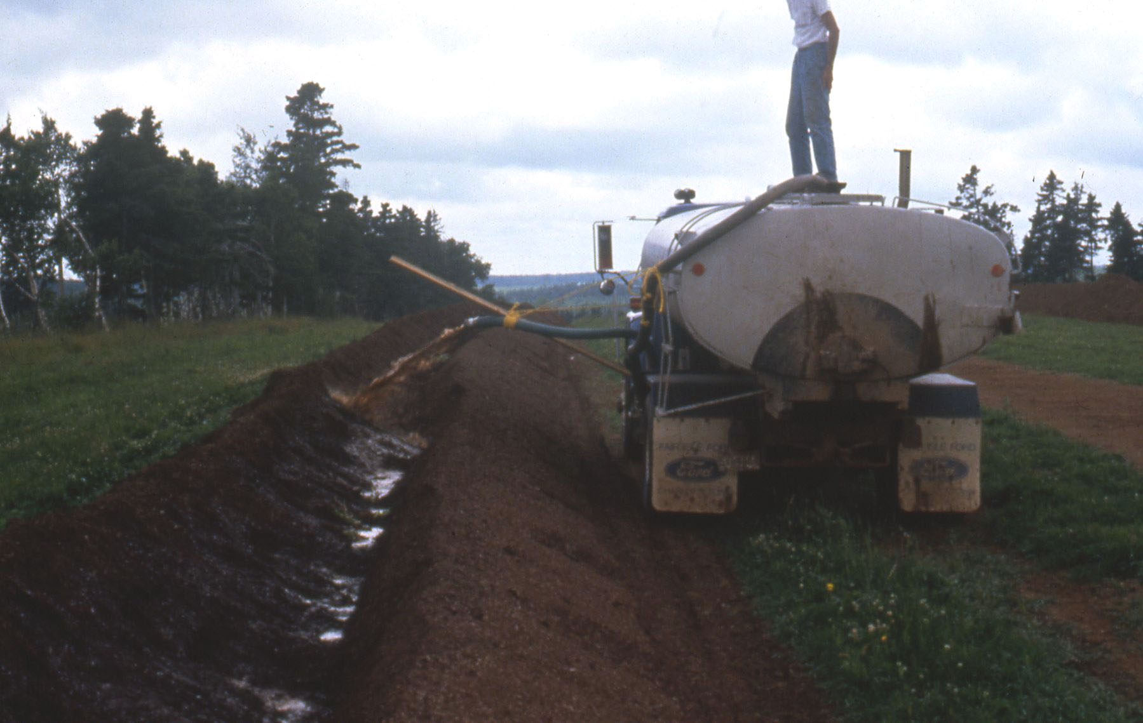
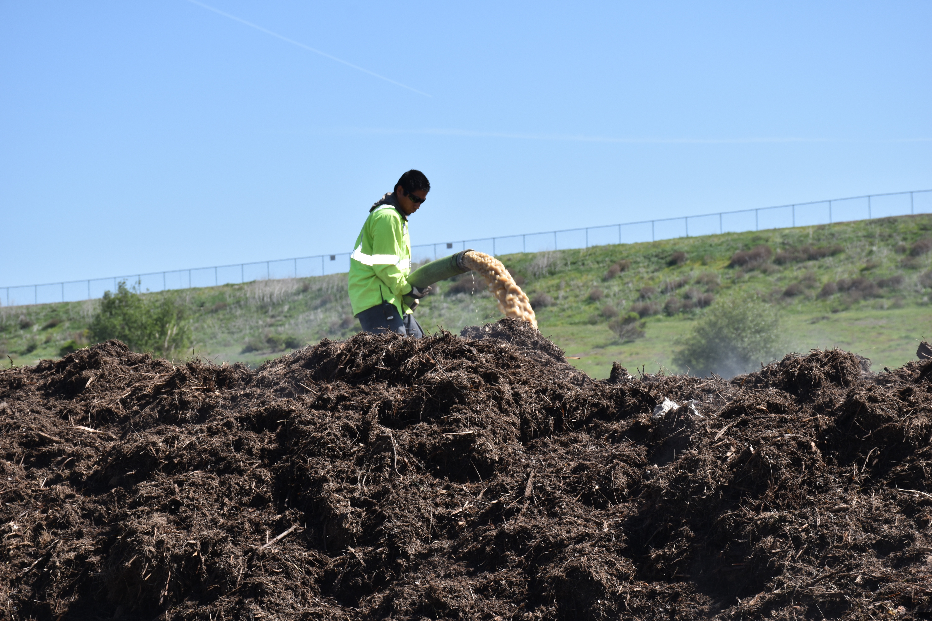
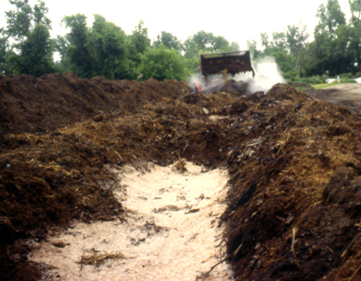
Adding High Moisture Feedstocks

Slide 20
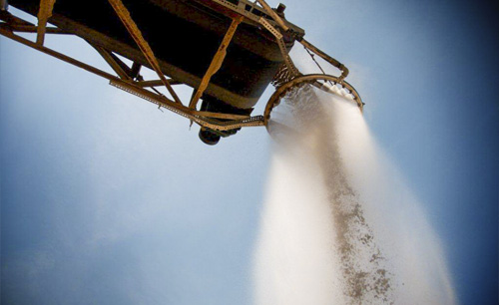
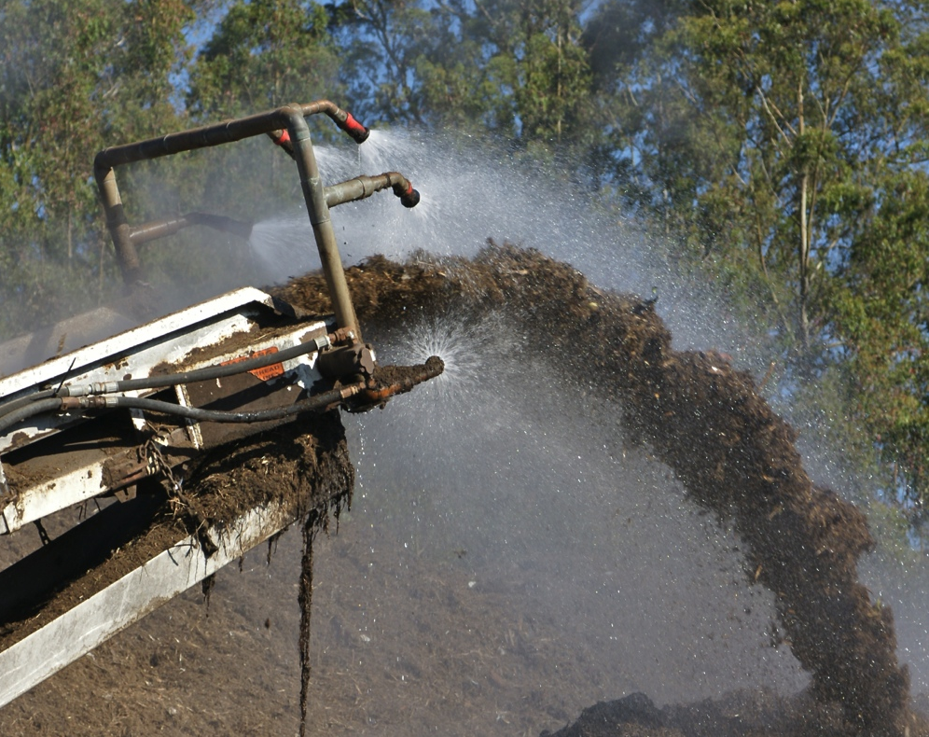
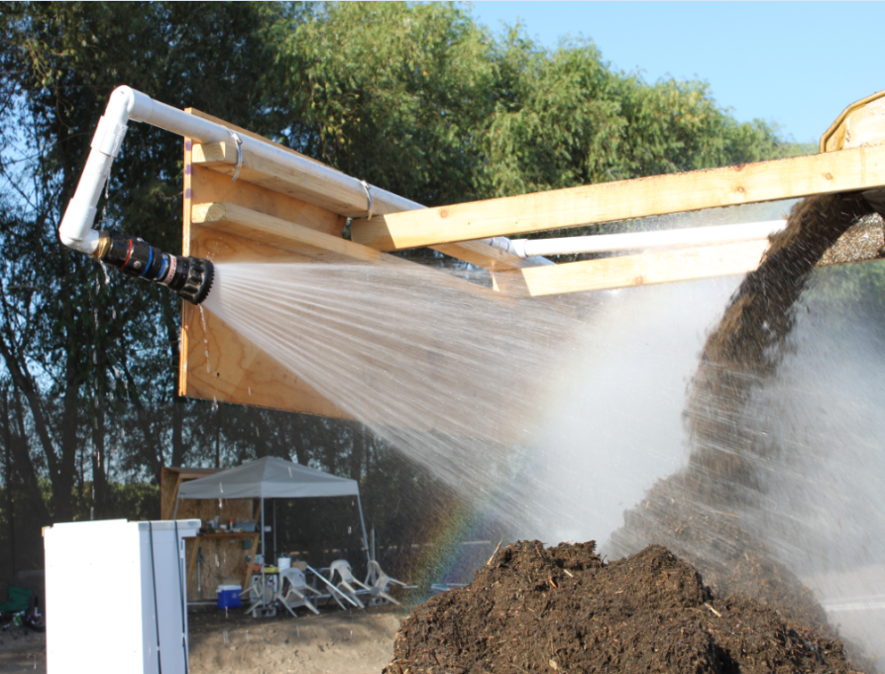
Watering while grinding

Slide 21
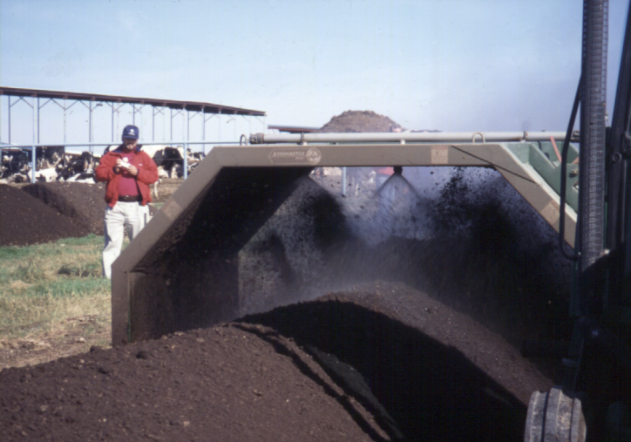
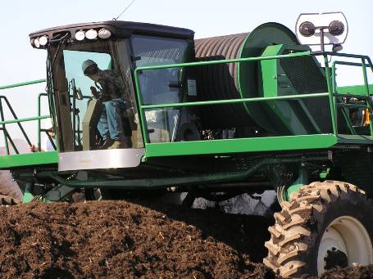
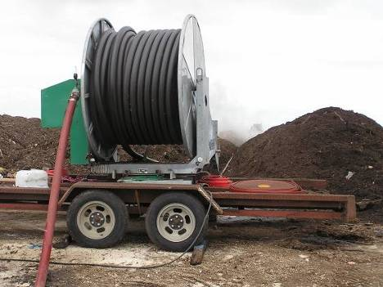
Keeping it Moist – Best to add water before or while turning

Slide 22
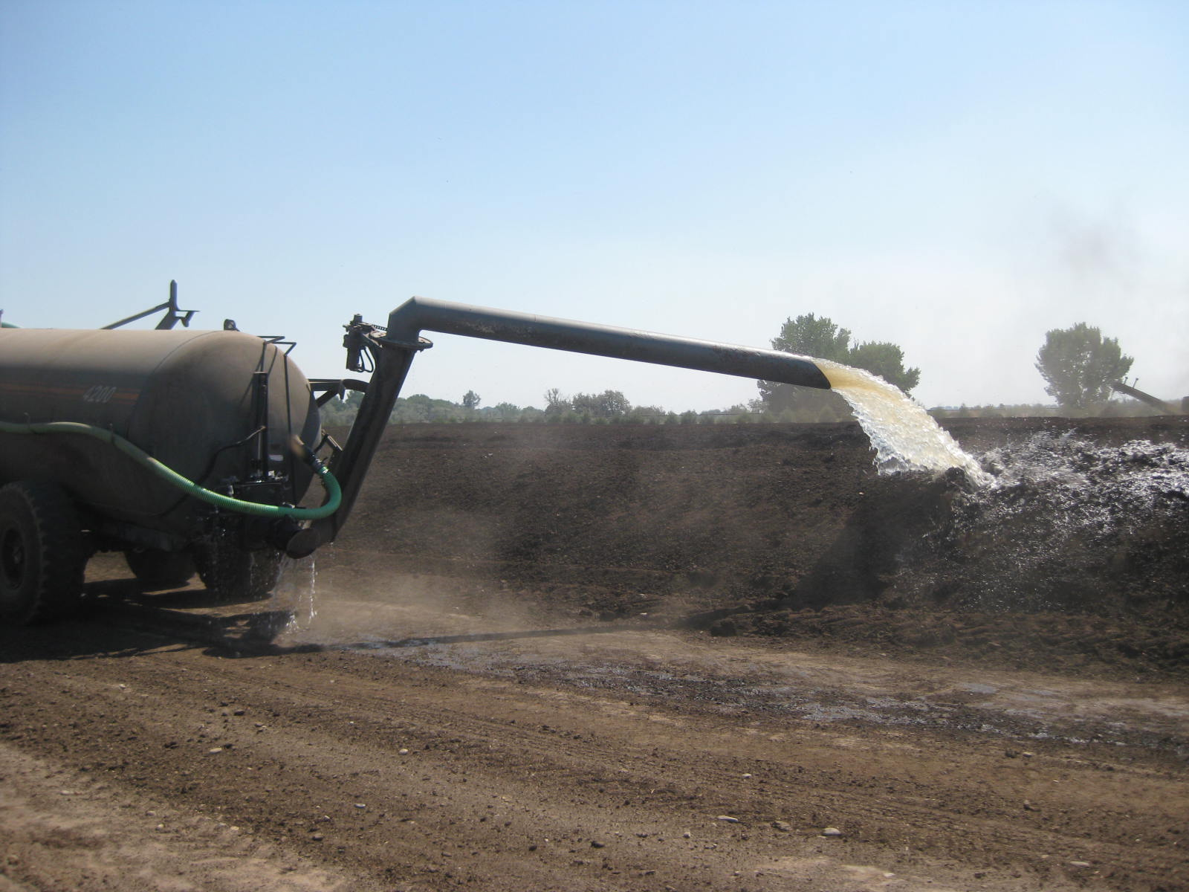
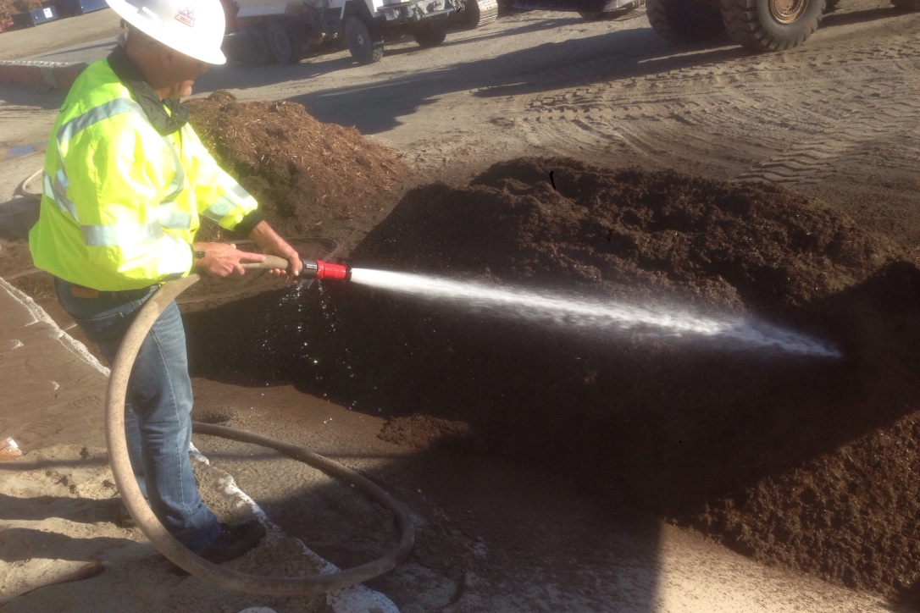
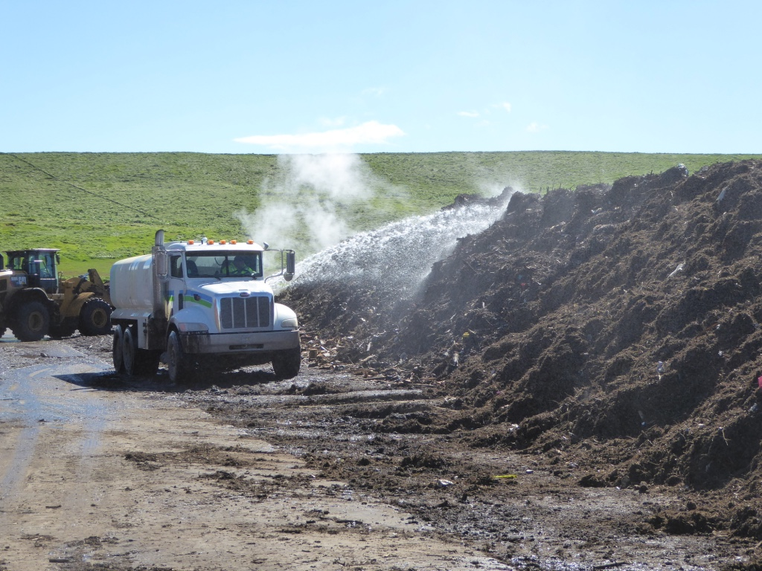
Keeping it Moist – Watering/Irrigation

Slide 23
2. Oxygen (O₂)
Required for aerobic respiration
Easily exhausted by microbial organisms
Some suggest O₂ levels > 10% ; even > 16%
Ambient air is 21% oxygen
Oxygen is delivered via aeration

Slide 24
“Passive” Aeration
Warm air
Diffusion
O₂ in
O₂ in
CO₂ out
CO₂ out
Cool
Ambient air
Cool
Ambient air
Adapted from slides by Rick Stehouwer, and Cary Oshins

Slide 25
Forced Aeration
Pressure
Mechanical blower (fan)
Air supply duct
(perforated pipe)

Slide 26
Forced Aeration - Suction
Treatment

Slide 27
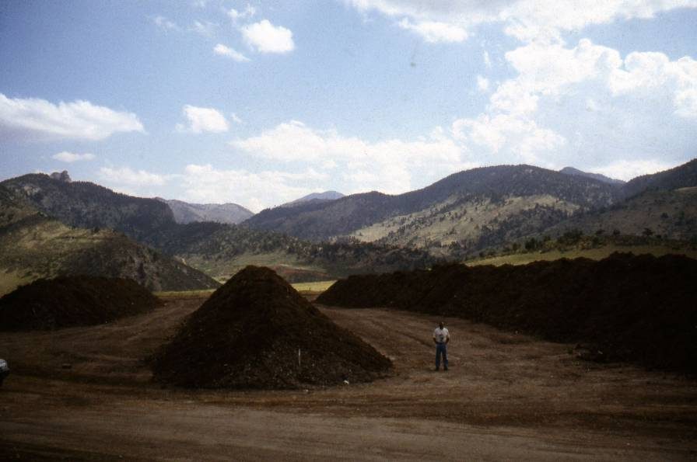
What Does Aeration Do?
Cools – removes heat
Dries – removes moisture
Purges - removes gases
Captures exhaust (if negative)
Provides fresh air with 21% oxygen
Notes:
27

Slide 28
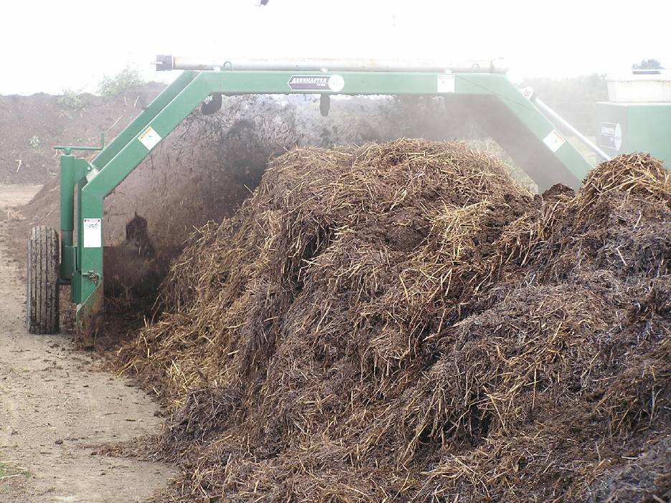
What Does Turning Do?

Slide 29
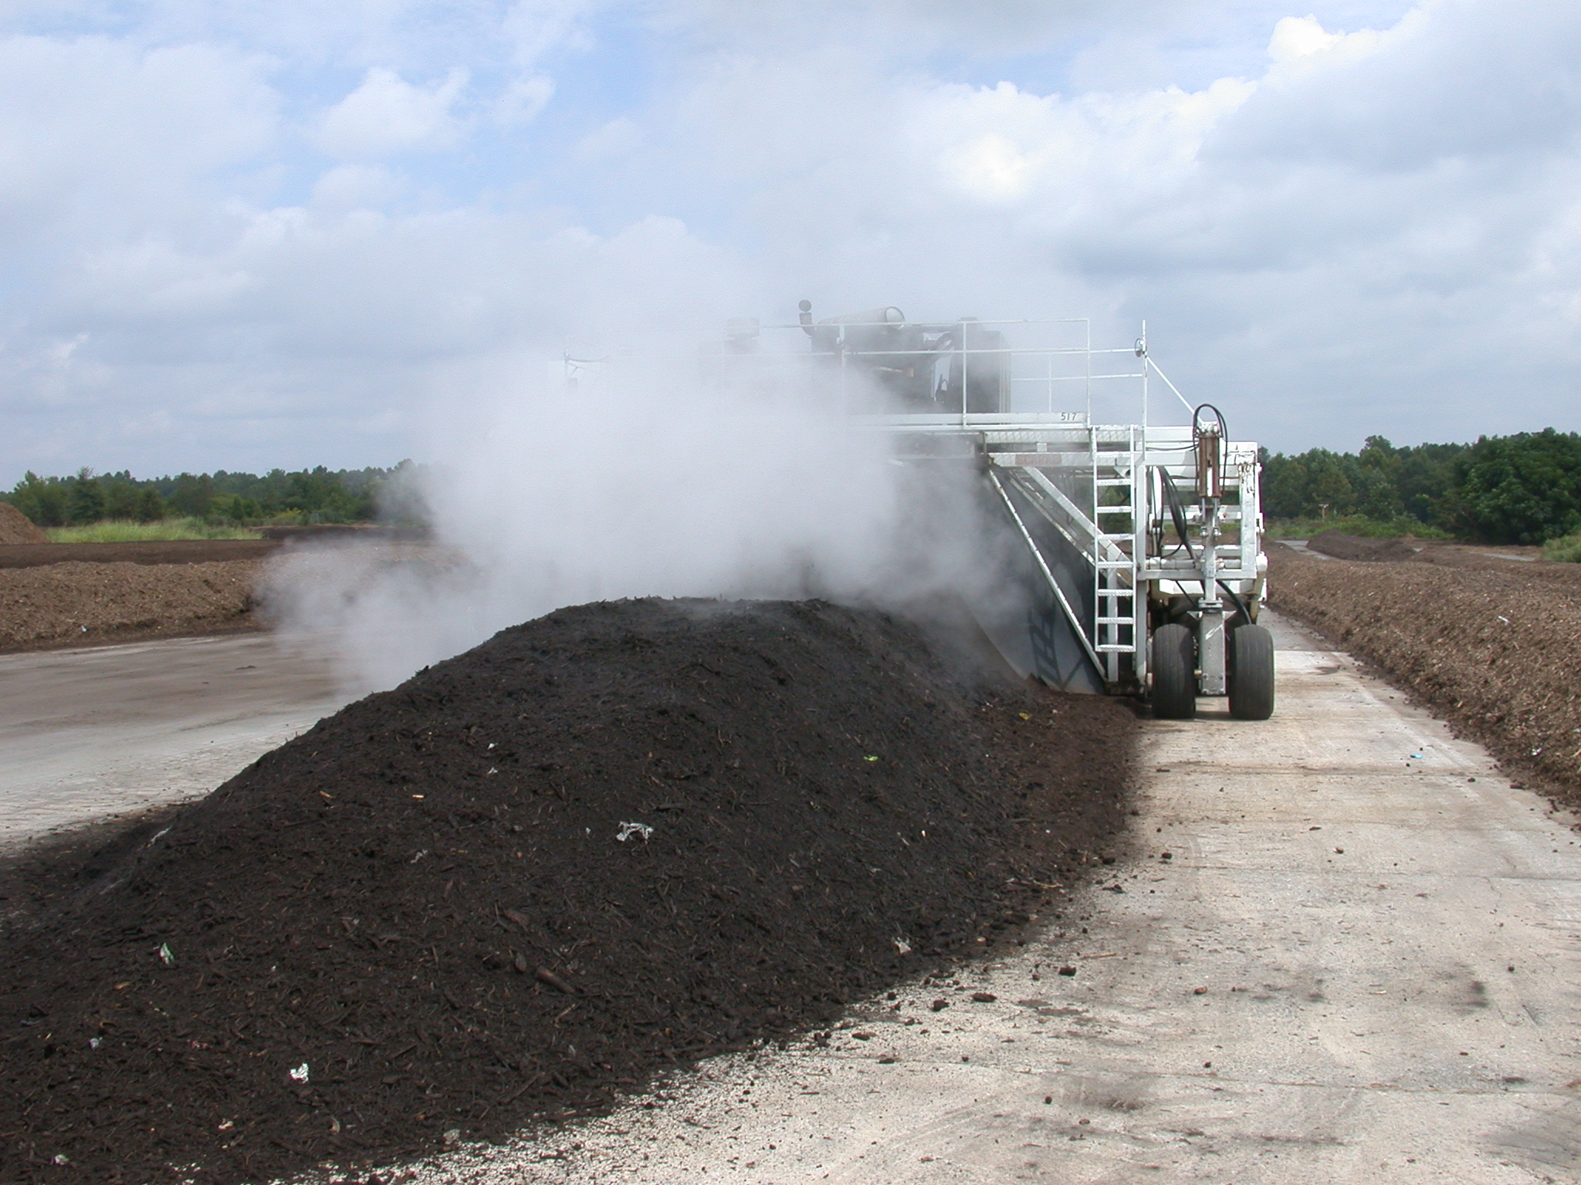
What Does Turning Do?
Charges the pile with fresh air
Releases trapped heat, moisture and gases (for better or worse)
Re-distributes moisture, nutrients, organisms, etc.,
Breaks up air channels
“Fluffs” … maybe
Shreds particles
Breaks apart clumps of materials
Generally invigorates
→ bursts of activity
Notes:
Charges the materials with fresh air
Releases trapped heat, moisture and gases (for better or worse)
Distributes moisture, nutrients, organisms
Breaks up and redistributes air channels
“Fluffs” … maybe
Shreds particles
Breaks apart clumps of materials
Generally invigorates → bursts of activity

Slide 30
Aeration
Without fans, aeration relies on diffusion and convection (passive aeration)
However, all aeration determined by:
  Porosity, bulk density, & particle size
  Compaction (pile height and structure)
  Moisture
  Pile shape and size (especially height)

Slide 31
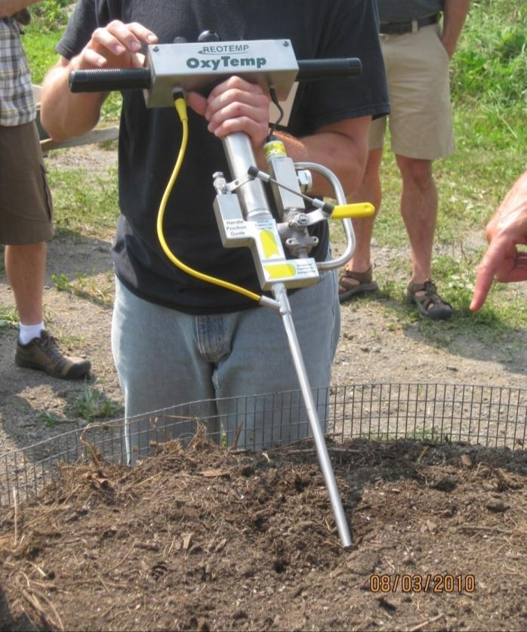
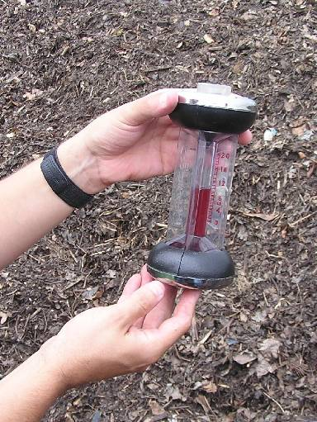
O₂/CO₂ Monitoring

Slide 32
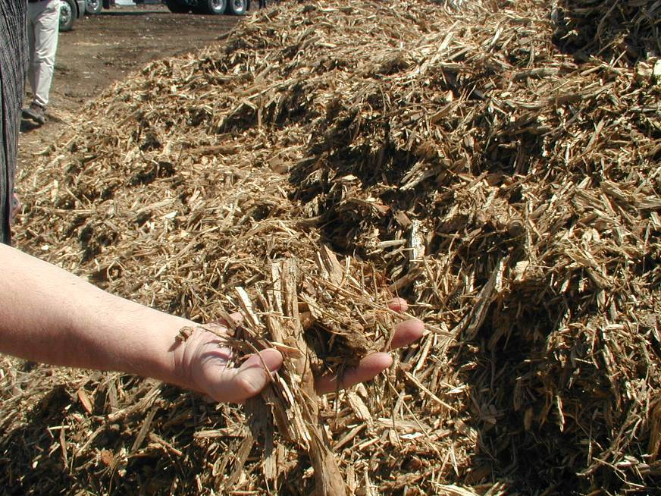
3. Pile “Mechanics”
Notes:
Porosity/Particle Size - 30 to 35 percent free air space (5 to 15 percent oxygen)
Probably more underrated in commercial composting
Need to have space for air to flow, contradict gravity.
Can also be measured in the field with a known volume container
Equipment selection and handling practices affect porosity.
Particle size
Porosity/FAS
Structure
Density
Pile size

Slide 33
Particle Size & Surface Area
organic
particle
Notes:
Organisms work from the surface inward

Slide 34
Particle Size & Surface Area
Smaller particles have more surface area than larger particles of equal volume so decomposition is faster.
BUT: Small particles restrict air flow

Slide 35
Pile Structure/Porosity
Free air space
Liquid film
Biodegradable particles
airflow
Aerobic
Anaerobic
- low pore space and FAS
Slides courtesy of Rick Stehouwer, Penn. State Univ.

Slide 36
Pile Porosity and FAS
Free Air Space (FAS) is porosity minus the water-filled pores
Key to enabling gas exchange
  O₂ in  CO₂ out
Determined by:
  Particle sizes and size distribution
  Overall height of pile (compaction)
  Moisture content

Slide 37
Bulk Density
Measure of mass (weight) per unit volume
  Pounds per cubic foot
  Tons per cubic yard
  Kilograms per cubic meter
Lower bulk density usually means greater porosity and better aeration

Slide 38
Bulk Density
Non-compacted
Low bulk density
Compacted
High bulk density
Lost pore volume
Slides courtesy of Rick Stehouwer, Penn. State Univ.

Slide 39
Bulk Density
<800 pounds per cubic yard
Light and fluffy
800 – 1,000 pounds per cubic yard
Just right
1,000 – 1,200 pounds per cubic yard
Heavy, hard to aerate, loss of pore space
>1,200 pounds per cubic yard
Too dense, very difficult to aerate
Notes:
Don’t make concrete-
Your pile needs to breathe!

Slide 40
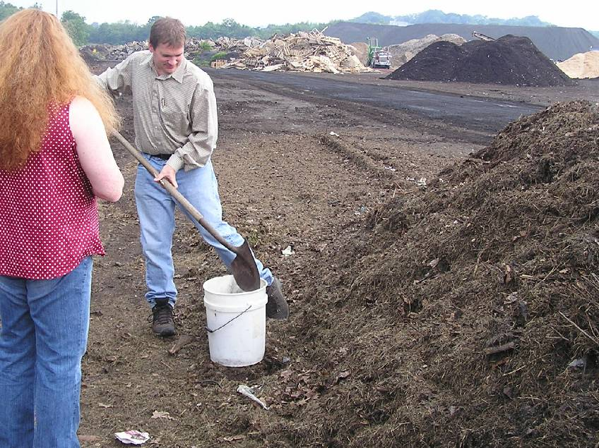
Measuring Bulk Density

Slide 41
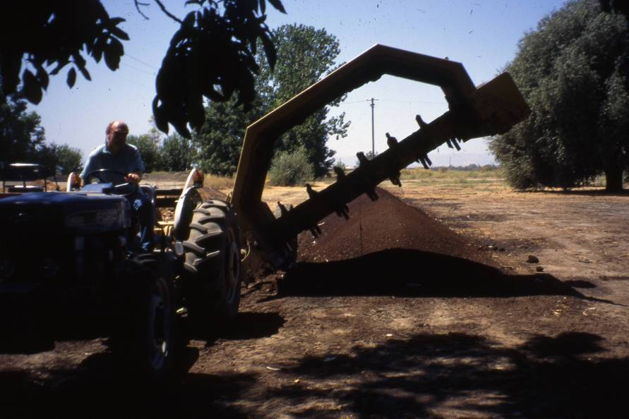
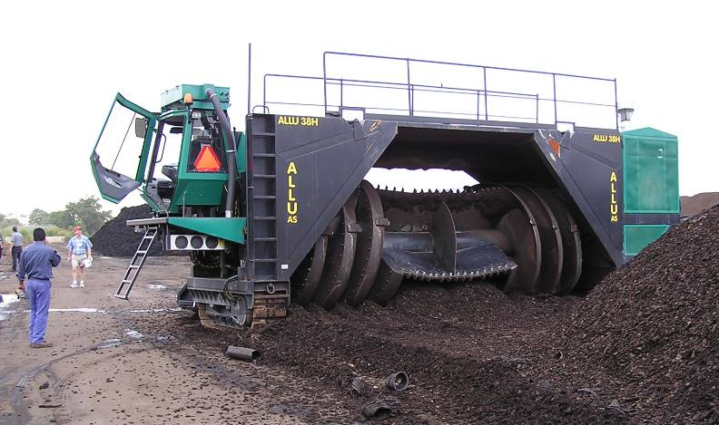
Windrow size depends on machine dimensions

Slide 42
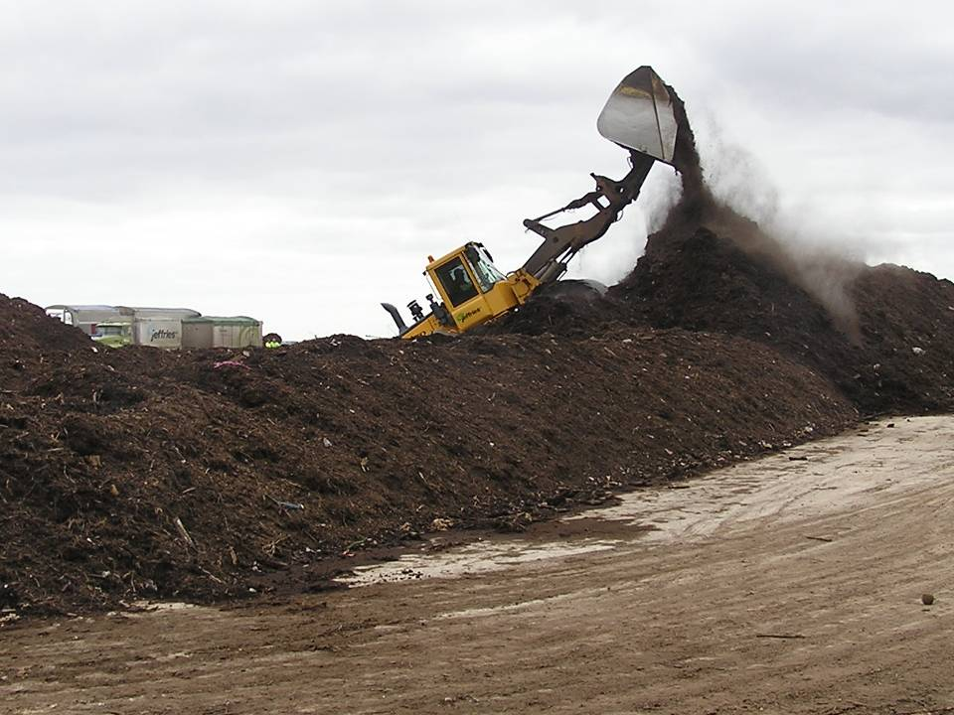
Windrow size depends on machine dimensions and capabilities
If you have to drive onto the pile, it is too big

Slide 43
Pile Size
Smaller piles allow for greater air flow, especially to center of pile
Larger piles retain temperatures (and moisture)
Large piles more difficult to monitor
Too large compacts bottom of pile
  Reduces porosity and airflow
Denser feedstocks in smaller piles
  Manures, food wastes: smaller, 4-6’ high
  Leaves, brush: higher, 6-10’ high
Equipment must match pile size

Slide 44
4. Feedstocks
Your raw materials
Where composting starts
Have the biggest impact on the characteristics of the finished compost
May be composted alone or combined

Slide 45
Types of Feedstocks
Primary Feedstocks
  Solids
  Liquids
  Semi-solids
Additives
  Bulking Agents
Amendments
Notes:
Primary feedstocks
Solids: homogeneous or mixed feedstocks, clean or contaminated
Liquids: beverages, oil & grease, some manures
Semi-solids: sludges (sanitary and non-sanitary)
Amendments balance the properties of the primary feedstocks
Bulking agents provide structure
keep pile from collapsing
maintain pore spaces for air movement

Slide 46
Feedstocks - Your Raw Materials
Organic Matter
Nutrients
Minerals
Moisture
Bulk Density
Degradability
Contaminants

Slide 47
Organic matter – once living
Always contains Carbon
Contains various amounts of other elements
  Nitrogen
  Phosphorous
  Oxygen, Hydrogen
  Sulfur
  K, Mg, Cu, Cl, etc.

Slide 48
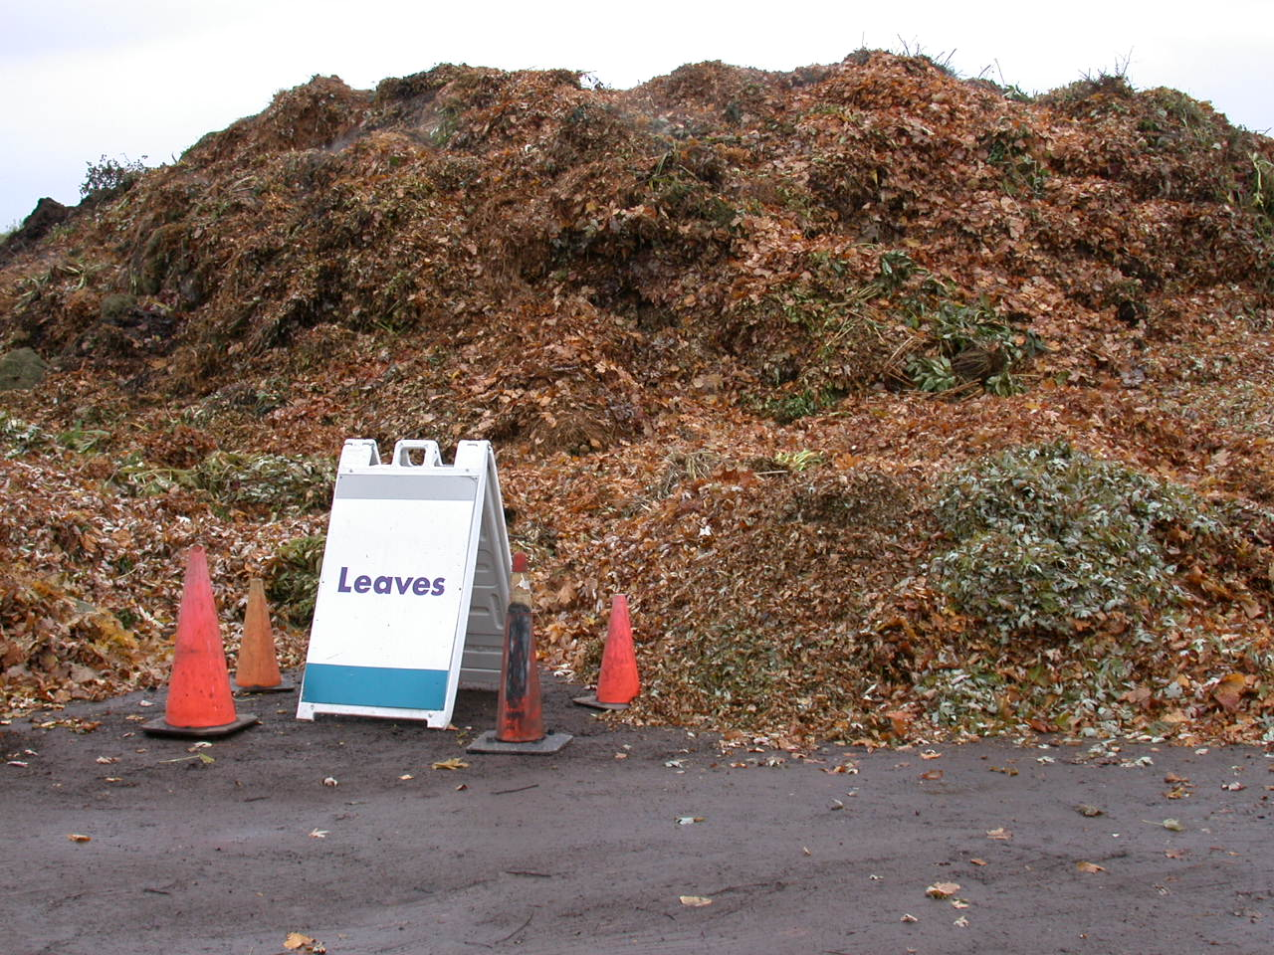
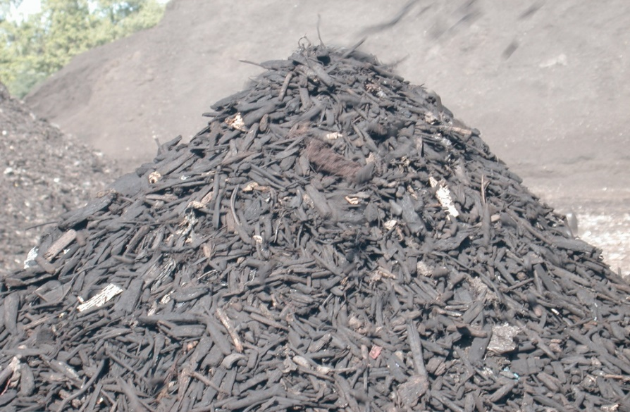
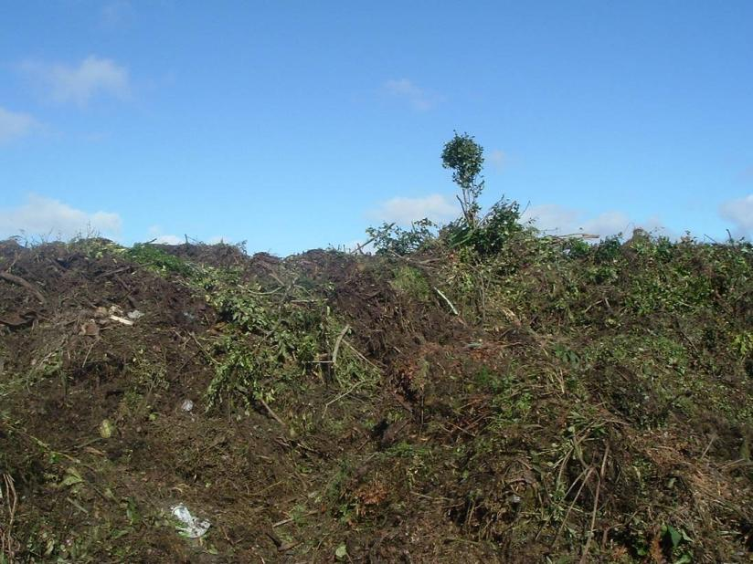
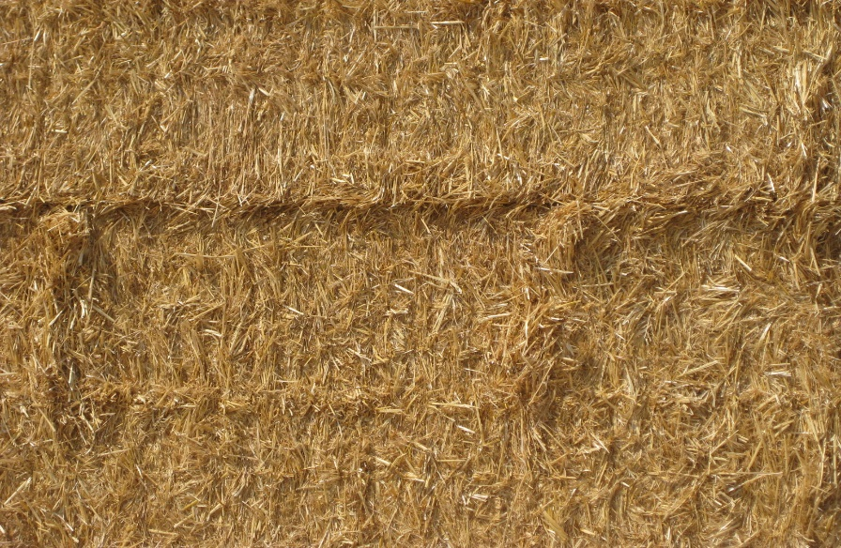
Common Carbon Sources

Slide 49
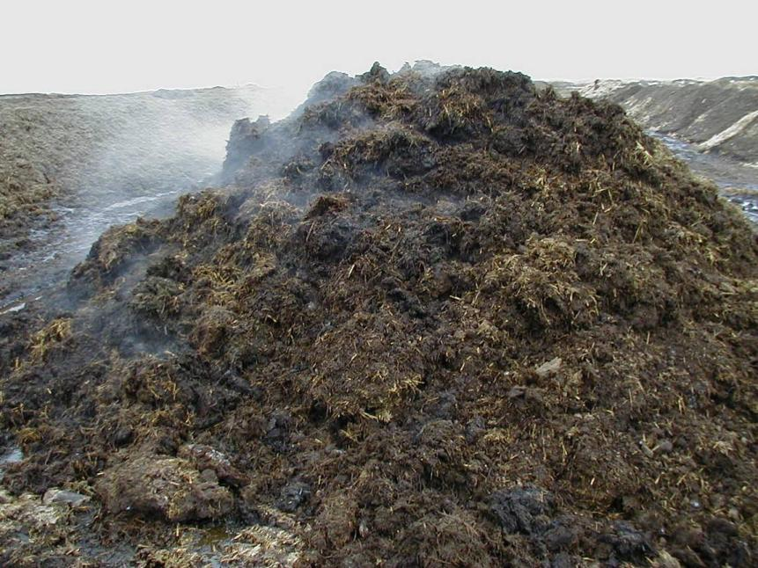
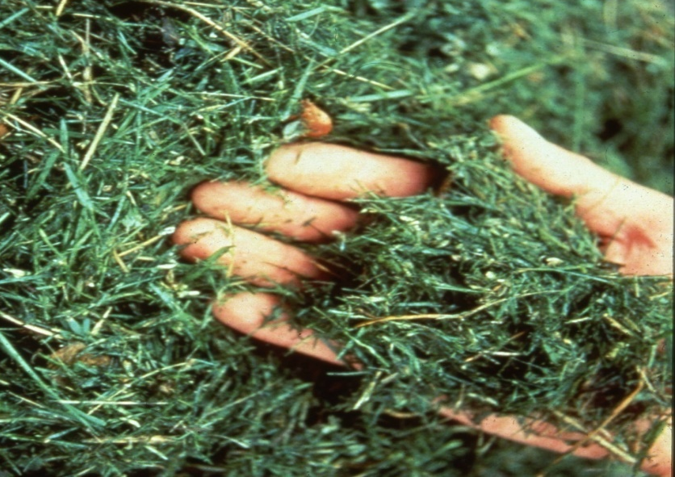
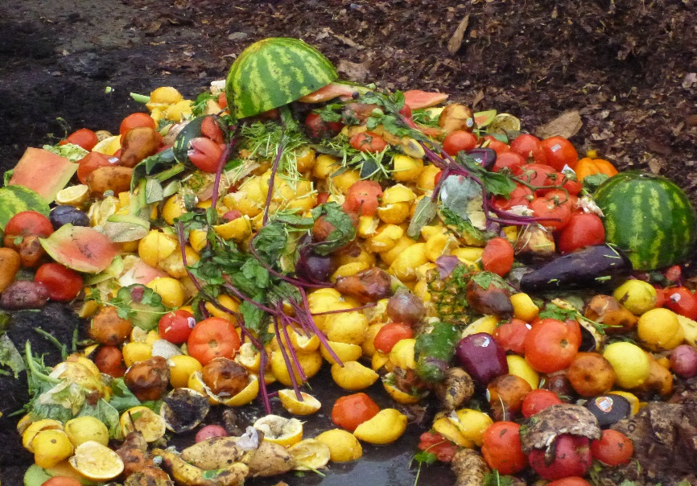
Common Nitrogen Sources
Portrait of Nitrogen

Slide 50
Carbon to Nitrogen ratio (C:N)
Ratio of total mass of carbon to total mass of nitrogen
Reflects the overall balance of nutrients
General gauge of feedstock balance, including nutrients AND moisture, porosity, bulk density, etc.

Slide 51
C:N Ratio by the Numbers
>50:1
Not enough N
20:1
Abundant N
Rapid decomposition. Moderate loss of N
<20:1%
Excess N
Rapid decomposition. Much loss of N
30:1
Considered ideal
Localized lack of N and excess N
Process slower but almost no N loss
Manageable decomposition rate and N conservation
Notes:
Matt says: Too little C causes most problems, adding C solves many.

Slide 52
Importance of C:N Ratio (N loss)
Larsen and McCartney; 2000

Slide 53
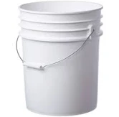
The Challenge of C:N Ratio
Must be measured in the lab (Total Carbon/Total Nitrogen), takes time.
Lab methods do not replicate pile conditions:
  Labs tend to grind all feedstock sample
  Typical C:N tells you nothing about available carbon
  C:N ratio tells you nothing about porosity
Heretical concept: Focus more on bulk density (initially) as a surrogate for porosity and C:N
  Limitations: Unusual feedstocks
  Just leaves

Slide 54
Most Degradable
Sugars
Starches, pectin,
Lipids, glycerols
Amino acids
Urea
Proteins
Hemicellulose
Cellulose
Chitin
Lignin
Lignocellulose
Disappear fast
food, processed paper, green vegetation
Slower
but largely gone
other food, straw, leaves, stems, crab shells,
Tough Stuff →
Most Remains
wood, other fibers
Least Degradable

Slide 55
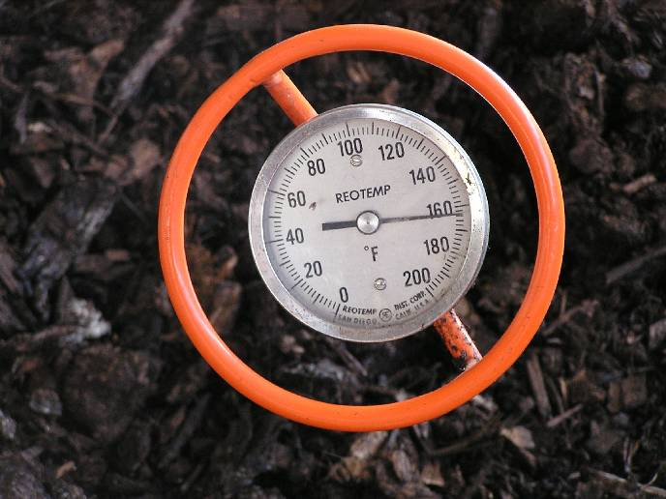
5. Temperature

Slide 56
Temperature
Higher temps result in faster breakdown up to around 140-150°F (60-65°C)
Above 160°F (71°C) lose microbial diversity, composting actually slows
Most weeds and pathogens killed at temps. 131°F (55°C) or higher
(Compost is a VERY good insulator)
Notes:
Temps above 140: pile doesn’t compost faster
(Will discuss PFRP on the next slide)

Slide 57
Process to Further Reduce Pathogens
Time and Temperature requirements to assure pathogen reduction:
Aerated Static Pile and In-vessel:
  131ºF (55ºC) or higher for 3 days
Turned windrow:
  131ºF (55ºC) or higher for 15 days or more with 5 turnings

Slide 58
Process to Further Reduce Pathogens
For Windrow Composting:
Turn #1
Turn #2
Turn #3
Turn #4
Turn #5
DAY
1
2
3
4
5
6
7
8
9
10
11
12
13
14
15
Temp. ≥ 131° F / 55° C
No Insulating layer

Slide 59
6. Time
2 months to 2 years
More typically 3 to 9 months
Depends on (in rough order of importance):
  Intended use
  Feedstocks
  Management Intensity
    Conditions (e.g., moisture and C:N ratio)
    Attention (e.g., frequency of turnings)
    Effectiveness of aeration
  Temperature

Slide 60


Questions?

Slide 61
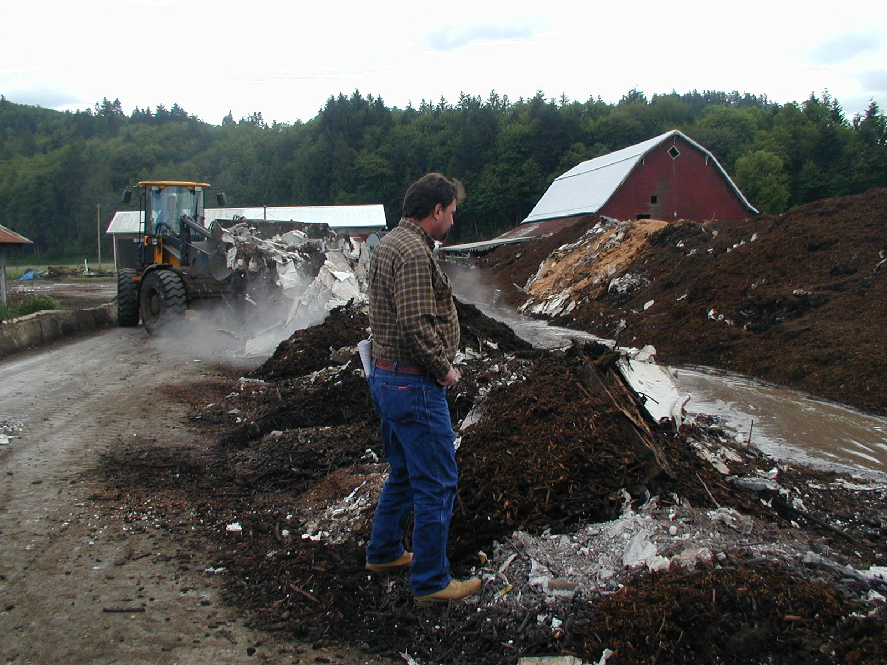
Recipe Development
Was this a good idea?
Chicken blood and fat, blended with Fish, YW, Sheetrock, and Wood
Photo Credit: Jeff Gage, Green Mountain Technologies

Slide 62
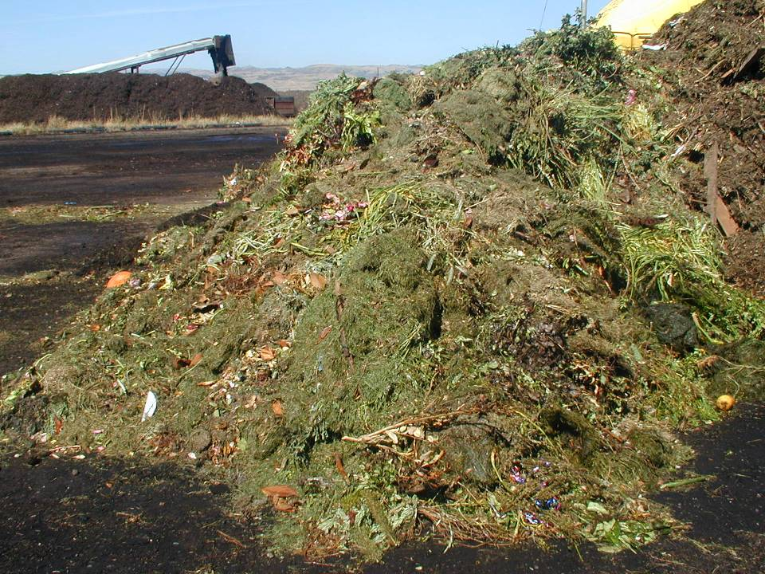
Sometimes feedstocks are adequately balanced
Mixed yard trimmings

Slide 63
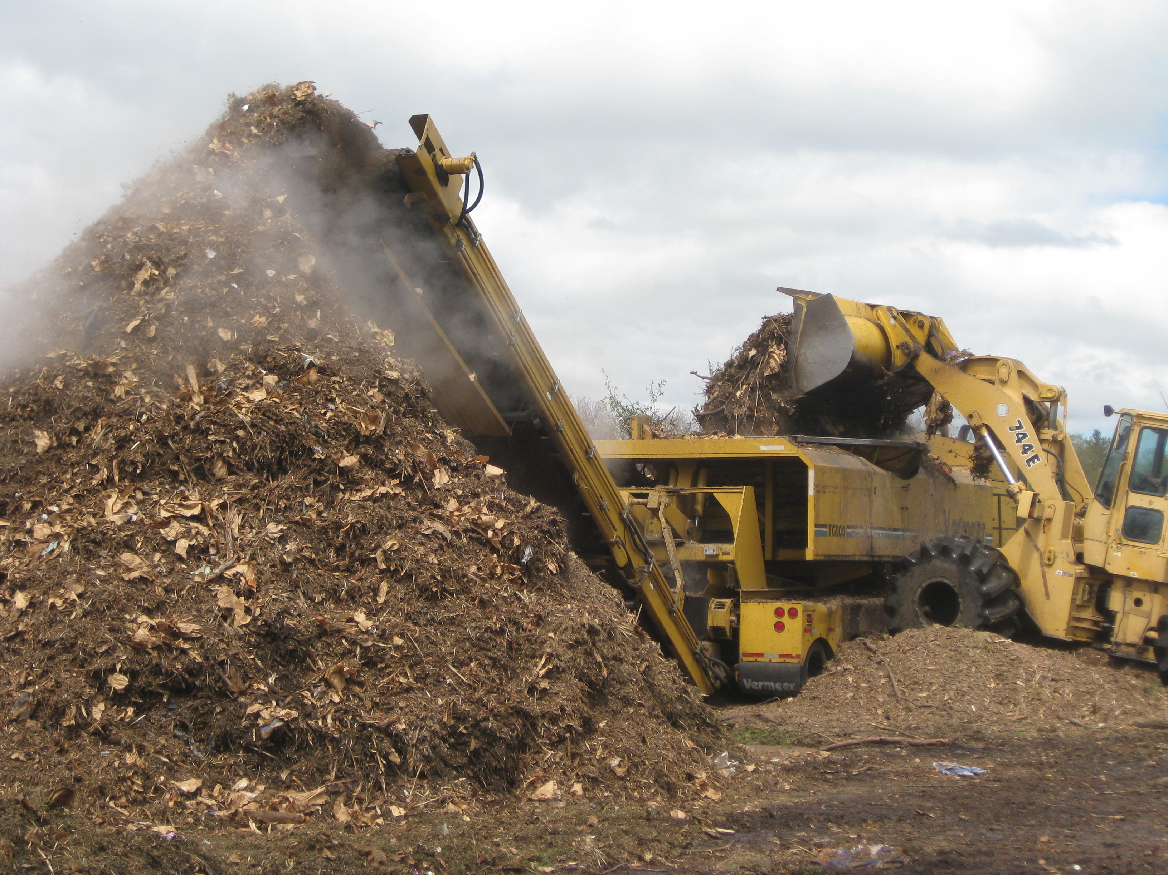
Sometimes not. Too little N
Shredded brush and fall leaves

Slide 64
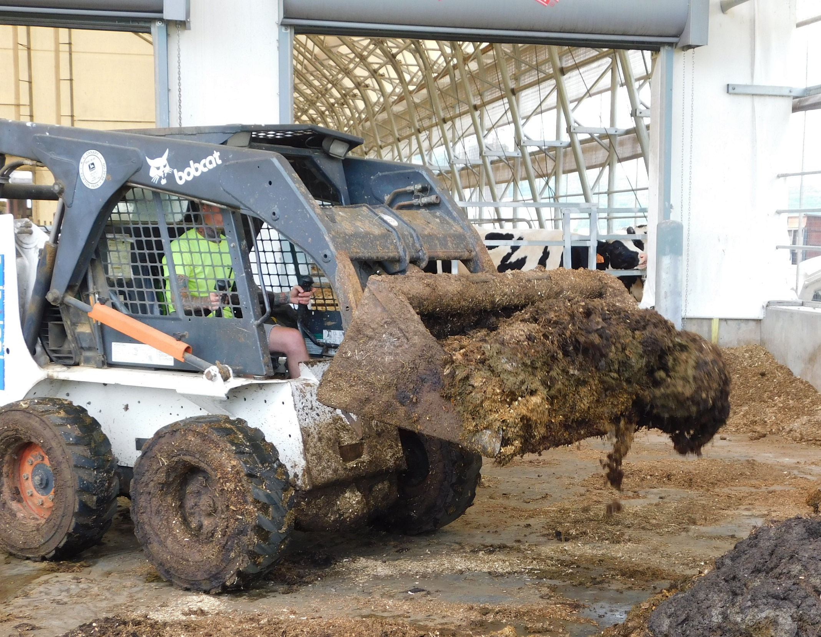
Sometimes not. Too much N
(and not enough structure)
Dairy manure

Slide 65
Mix ingredients together to create a better balance
“Carbon”
“Nitrogen”
Brush/Leaves
Low N
Dry
Bulky
Grass/Food
Low C
Wet
Dense

Slide 66
Starting Targets For Composting
Initial moisture 50 to 60% great; 40 to 65% OK
Moist, NOT soggy or dry
Initial C:N ratio In theory: 25 to 35:1
In practice: 35:1 to 40:1, up to 60:1
(Available carbon important)
Bulk density Shoot for 800 lbs/cu. yard
< 1,000 OK; > 1,200 unacceptable Only going to get more dense
Notes:
Slide credit: Bob Rynk

Slide 67
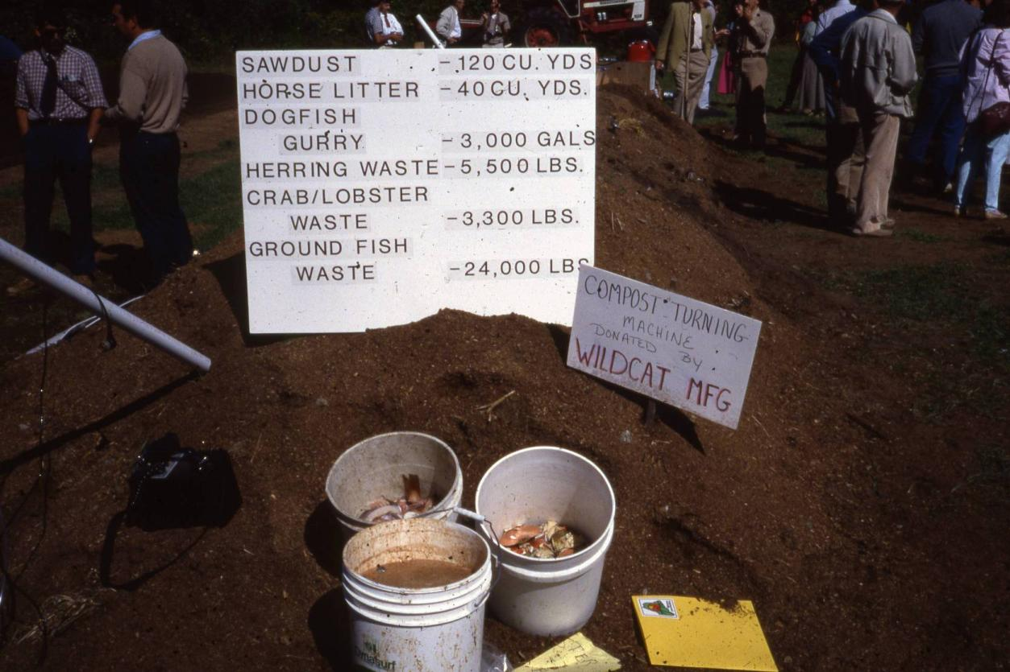
160 cy
Dry Amendments
15 cy
4 cy
14 cy
14 cy
about 40 cy
of seafood
Typical recipe:
4 volumes of ‘browns’ to 1 volume of ‘greens’

Slide 68
Balancing Moisture & C:N Ratio
100
80
Wet/High N
Wet
Wet/Low N
60
High N
Ideal
Low N
Moisture Content
40
20
Dry/High N
Dry
Dry/Low N
0
0
20
40
60
80
C:N Ratio
…but there are other variables too.

Slide 69
Strategies for Combining Feedstocks
  Make the best of what you have
  Look and feel
  Trial and error
  Tried and true
  Moisture
  Bulk density
  Balancing moisture AND C:N ratio (w/ math)
Notes:
<slide credit: Bob Rynk>

Slide 70
Strategies for Combining Feedstocks
  Make the best of what you have
  Look and feel
  Trial and error
  Tried and true
  Moisture
  Bulk density
  Balancing moisture AND C:N ratio (w/ math)
Notes:
<slide credit: Bob Rynk>

Slide 71
Recipe Calculations → Tailor-made for a Computer Spreadsheet
A good one here:
http://puyallup.wsu.edu/soils/compost-mix-calculator/

Slide 72
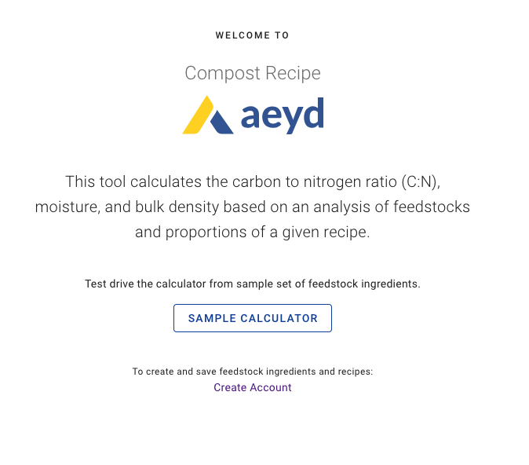
https://recipe.aeyd.io/

Slide 73
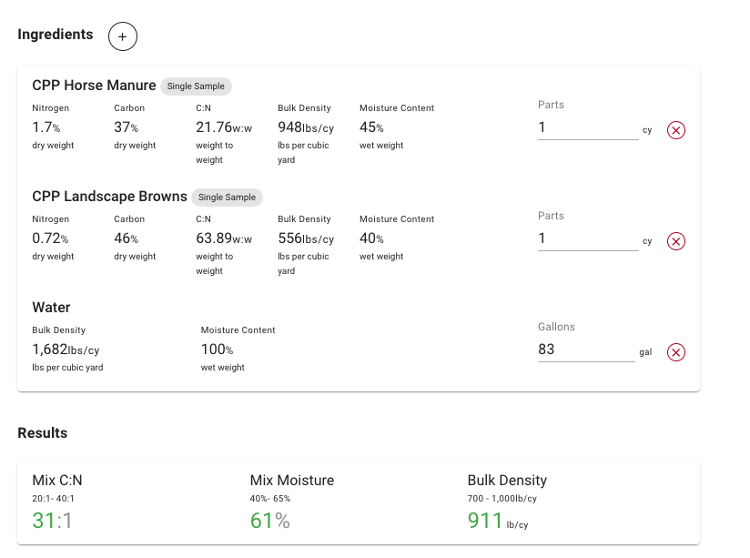
Sample Recipe (Simple)

Slide 74
APPENDIX B -- THE COMPOSTING HANDBOOK
TYPICAL CHARACTERISTICS OF COMMON FEEDSTOCKS -- MOISTURE, C, N, BULK DENSITY
Latest revision: December 20, 2021
Example Feedstock Characteristics -- Total N, Total C, C/N, moisture, and bulk density
Compiled by: Jorge Montezuma, Atlas Organics; Cary Oshins, U.S. Composting Council; Andy Bary, Washington State University; and Robert Rynk, SUNY Cobleskill
 | C:N Ratio | Moisture | Bulk Density
Horse Manure | 30 | 72% | 1,379 | Assumed with bedding
Wood Chips | 100 | 47.5 | 725
Food Waste | 20 | 75 | 1887
Yard Waste (Leaves) | 54 | 45 | 455

Slide 75
SMSC numbers:
Feedstock | Month | Year | Carbon | Nitrogen | Moisture | CN
Yard Waste | July | 2021 | 27.2 | 1.6 | 43.6 | 17
Wood | March | 2021 | 44 | 0.44 | 33.6 | 100
Canterbury Manure | June | 2021 | 32 | 1 | 43.4 | 32
Vierkant (curbside food) | February | 2021 | 45 | 2.5 | 68.8 | 18
Organix (food) | January | 2021 | 46.4 | 1.6 | 78.7 | 29

Slide 76
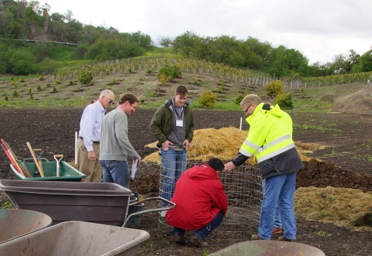



No Spreadsheet?
Make a Test Pile!

Slide 77
Questions?

